Slide 2
At the heart of DIVISION...not revealed Truth from God
Philippians 2:3
Selfish ambition, or conceit
“doing nothing through faction or through vainglory...”
Corinth I Cor. 12:20
Judgment Coming... Gal. 5:20, Rom. 2:8
Warnings Given... Titus 3:10
Diotrephes 3 Jn. 9
Confusion Jms. 3:16

Slide 3
“let each esteem others better than himself.” Phil. 2:3
Remedy...
Have Humility of Mind

Slide 4
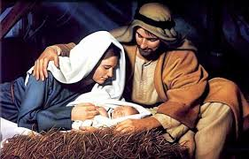

2 Cor. 8:9
Jesus
“Not looking each of you to your own things, but each of you also to the things of others” Phil. 2:4
Though God...counted not the equality with God (sharing His glory) a thing to be grasped ...” (Phil. 2:6, Jn. 17:5)
But emptied Himself, taking on the form of a servant (Phil. 2:7)
Being in likeness and fashion of man, He humbled Himself being obedient to death - (Phil. 2:8)
“Yea, the death of the cross”
The Mind: Humbles self – Looking to the things of others

Slide 5
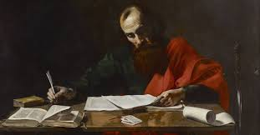
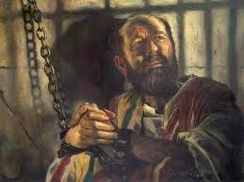
Paul
“Not looking each of you to your own things, but each of you also to the things of others” Phil. 2:4
Yea, and if I am offered upon the sacrifice and service of your faith, I joy, and rejoice with you all: and in the same manner do ye also joy, and rejoice with me. (Philippians 1:17-18)
The Mind: Humbles self – Looking to the things of others

Slide 6
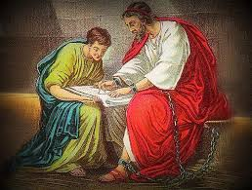
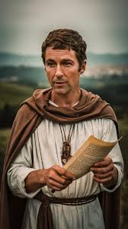
Timothy
“Not looking each of you to your own things, but each of you also to the things of others” Phil. 2:4
But I hope in the Lord Jesus to send Timothy shortly unto you, that I also may be of good comfort, when I know your state. For I have no man likeminded, who will care truly for your state. For they all seek their own, not the things of Jesus Christ. (Philippians 2:19-21)
The Mind: Humbles self – Looking to the things of others

Slide 7
Epaphroditus
“Not looking each of you to your own things, but each of you also to the things of others” Phil. 2:4
But I counted it necessary to send to you Epaphroditus, my brother and fellow-worker and fellow-soldier, and your messenger and minister to my need; since he longed after you all, and was sore troubled, because ye had heard that he was sick... (Philippians 2:25-26)
The Mind: Humbles self – Looking to the things of others

Slide 8
The Humble Mind – Caring For Others
Will it unite Euodia and Syntyche (Phil. 4:1) ?
Try it in improving relationships with brethren
Try it to help heal fractured marriages
Try it in raising children
Try it among fellow workers and classmates

Slide 9
The Humble Mind – Caring For Others
You will try it if...
  there is any exhortation in Christ
  there is any consolation of love
  there is any fellowship of the Spirit
  there is tender mercies and compassions
  you care for Paul’s joy

