Slide 1
Heeding Divine warnings...
Be wise – wine is a mocker (Prov. 20:1)
Follow Instructions - do not be deceived with is alluring beginnings... (Prov. 23: 31-32)
Have a clear mind – abstinence (Prov. 31:5-7)

Slide 2
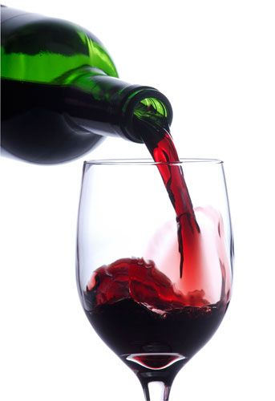
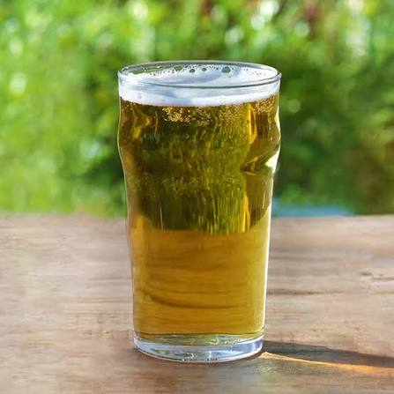

12 oz beer 5% alcohol by volume
1.5 distilled liquor – 40 % alcohol by volume
5 oz. wine – 12% alcohol by volume
.6 ounces of pure alcohol,
.02 – .03 percent BAC - prefrontal cortex impacted

Slide 3
What begins in the brain...
.02-.03 BAC
Impulse control, judgment, decision making is affected
Mood changes occur
Judgment begins to weaken
Attention and concentration decline
Alertness reduced
Inhibitions decrease
I am not drunk yet - .08 BAC

Slide 4
Living life with Spiritual Clarity...
Being SOBER (nepho) (I Thess. 5:6-8; I Pet. 1:13, Titus 2:2-3, I Tim. 3:2,3, I Tim. 3:8, 11; Pet. 5:8)
Being of SOUND MIND (sophron) (cf, I Pet. 4:7)
Being SELF-DICIPLINED (Engkrateia) (1 Cor. 9:25, Titus 1:8, 2 Pet. 1:5-6)

Slide 5
Not Being a stumbling block... :
Timothy exhorted to “take a little wine” for his stomach’s sake – impurities in water affecting his stomach (I Tim. 5:23)
Drinking parties (potos) – “social drinking” condemned along with “drunkenness” (I Pet. 4:3)
Serious consequences if we do not abstain (Rom. 14:13, 15-16, 21)
  No longer walking in love
  Destroying one for whom Christ died
  Your good is evil spoken of
  Sinning against Christ (I Cor. 8:12)

Slide 6
Abstinence from Drinking Alcohol is not legalism...
But It is heeding the warnings of Scripture and living with spiritual clarity, self-control and caution of the snares of this world.
But is making sure one is not going to be a stumbling block to others – living in love for others
But is honoring our body as a temple of the Holy Spirit (I Cor. 6:19-20, 18)

