Slide 1
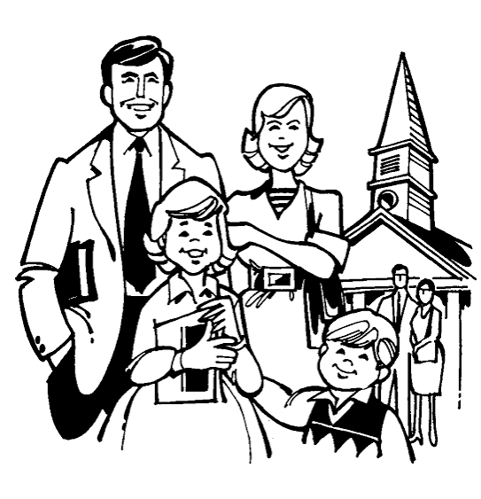
The INDIVIDUAL and the CHURCH
The CHURCH is not the BUILDING
The INDIVIDUAL is not the CHURCH

Slide 2

THE INDIVIDUAL AND THE CHURCH DISTINCTION
Jesus
church
ekklēsia – “called out” Eph. 1:22-23
Individuals were added to the church... Acts 2:41,47
“Called you through our Gospel” 2 Thess. 2:14

Slide 3
INDIVIDUAL RESPONSIBILITY IN THE CHURCH
Miraculous Gifts would end when the Written Word was Completed I Cor. 13: 8-10
Members one of another Rom. 12:4-5
Jesus
Prophecy, Serving Teaching, Exhorting, Giving, Ruling, showing mercy Rom. 12:7-8
Elders leading and overseeing and Deacons Serving Phil. 1:1, Heb. 13:17, I Pet. 5:2 Acts 14:23

Slide 4
INDIVIDUAL RESPONSIBILITY IN THE CHURCH
Having same care for one another I Cor. 12:25-26
Members one of another Rom. 12:4-5
Jesus
Prophecy, Serving Teaching, Exhorting, Giving, Ruling, showing mercy Rom. 12:7-8
Assembling for worship: Lord’s Supper, Preaching, Singing, Praying, Giving
Heb. 10:24-25, Acts 20:7, Eph. 5:18-19, Acts 12:5, 12 I Cor. 16: 1-2

Slide 5
The Work of the CHURCH
EVANGELISM- proclaiming the Word – the Gospel Phil. 1:5, 4:15; 2 Cor. 11:8, Col. 1:7, Acts 8:4,11:19-20
BENEVOLENCE –helping needy saints I Cor. 16:1, Acts 2:44-45, 4:34-35, 11:29-30, 2 Cor. 9: 1, 7, 12-13; Rom. 15:26
Giving, Working, spreading the Word, helping and caring for one another
EDIFICATION – building up the saints – teaching
Eph. 4:12, 16

Slide 6
Distinct Individual Responsibility
Let not the church be burdened... I Tim. 5:16
Care for the needy – poor, orphans, widows, Gal.2:10, 6:10, James 1:27
What the individual can do the church can do???
Care for your own family members
I Tim. 5:4,8
By what authority?

