Slide 2
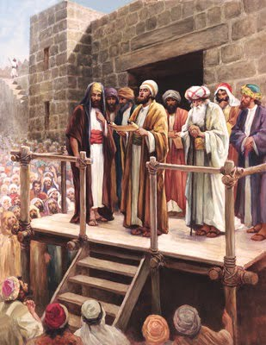
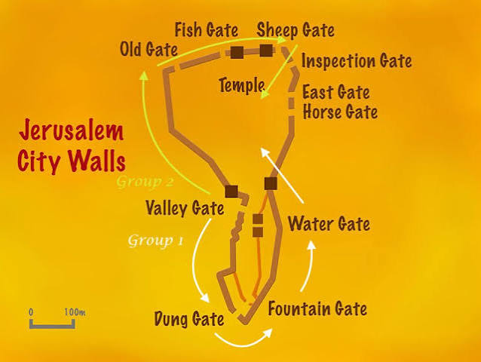
Ezra, Nehemiah, and the Levites caused the people to understand – read distinctly, giving sense (Neh. 8:7-9)
Reading of the Law of Moses – early morning till midday – 6 hours... (Neh. 8:1,3)
Ezra reads the Law – First day of the Seventh Month (Neh. 8:2)
Ears attentive unto the Book of the Law (Neh. 8:3)
People were respectful when the scroll is opened – bowed in worship unto Jehovah –” Bless” Jehovah (cf. Psm. 34:11)

Slide 3
Set Feasts of Jehovah for the Seventh Month (Lev. 23:23-44 )
Feast of Trumpets: Celebrated on the first day. It is a day of rest marked by the loud blowing of the ram’s horn a joyful shout to gather the people.
Day of Atonement: Held on the tenth day. It is the holiest day of the year. The people fast and confess their sins. The High Priest enters the Most Holy Place to make payment for the nation’s sins.
Feast of Tabernacles: Begins on the fifteenth day. Israelites live in temporary leafy booths for seven days. This acts as a real-world example to remember how God provided for them while wandering the desert.

Slide 4
The Exhortation...
Obey the Law – this day is holy unto Jehovah - not a day of weeping – Rejoice (Neh. 8:9-12)
Don’t be grieved – (Neh. 8:10)
FOR THE JOY OF JEHOVAH IS YOUR STRENGTH
Obey what is written – make booths – kept feast seven days – very great gladness (Neh. 8:13-18)

Slide 5
The Joy of Jehovah... Jn. 15:11
Begins when you obey the gospel – baptized in the name of Jesus Christ for the remission of sins (Acts 2:38, 8:35, 37,39)
Extended to others – to benefit others – receiving Epaphroditus; not being a stumbling block (Phil. 2:28-29, Rom. 14:14-19)
Does not end when having to confront doctrinal error (Phil. 3:1-3)
Can be with you always – even when you are anxious – peace is just a prayer away (Phil. 4:4-7)

Slide 6
Do not forget the joy in the cleansing of your sins... Do not be near sighted (2 Pet. 1:9-10)
Do not forget the joy of serving others... And become self-centered
Your joy in the Lord is your strength... Against the devil
Do not fall into the devil’s trap that confronting doctrinal error destroys joy
Strengthen your faith with joy in the Lord with prayer

