Slide 2
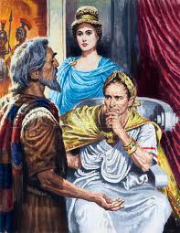
What Hinders People in Becoming Christians?
Felix and Drusilla
Paul
Acts 24: 24-27

Slide 3
People do not Convert because...
They Love this world more...
  Lust of the flesh, lust of the eye, the pride of life (I Jn. 1:16)
  Blinded of the truth ahead (I Jn. 1:17, 2 Cor. 4:4, Lk. 18:30)
  Love of money (Matt. 19:22-26, Acts 24:26)
  The pull of this world on followers of Christ – Demas (2 Tim. 4:10)

Slide 4
People do not Convert because...
They Love this world more...
They are merely “moved” (Acts 24:25, Acts 26: 27-28. Acts 26:29-32)
  “Fear” ...
  “Persuasion” ...
  Can quickly get back to “my business”

Slide 5
People do not Convert because...
They Love this world more...
They are merely “moved”
They put off making “the change” until a “convenient season” ( Acts 24: 25, I Tim. 4:7-10, Heb. 9:27 )
  Never convenient to repent – turn away from your sins
  Never convenient to change to “godly living”
  The day of reckoning comes – Judgement

Slide 6
so Christ was offered once to bear the sins of many. To those who eagerly wait for Him He will appear a second time, apart from sin, for salvation.
Picture
Yourself
Hebrews 9:28

Slide 7
I have fought the good fight, I have finished the race, I have kept the faith. Finally, there is laid up for me the crown of righteousness, which the Lord, the righteous Judge, will give to me on that Day, and not to me only but also to all who have loved His appearing.
Picture
Yourself
2 Timothy 4:7-8

