Slide 2
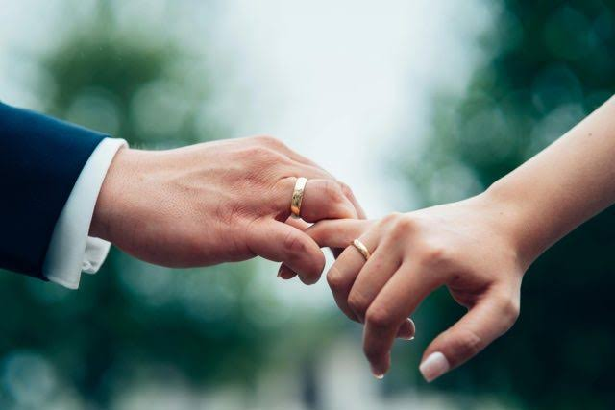
Whom Should I Marry?
God tell me verbally ? – Hosea 1:2-6
Let a representative pick the one by receiving a sign from God in prayer (Isaac, Rebekah) - Gen. 24:3-4,15
Give me a sign – gut feeling ?
...with a renewed mind proving what is the good, acceptable, and perfect will of God (Rom. 12:2)

Slide 3
Whom Should I Marry?
One who honors the Sanctity of Marriage
  God has instituted marriage – not man (Gen. 2:18-24)
  Keep marriage pure – marriage bed undefiled (Heb. 13:4)
  Recognizes the permanence – till death do us part, not when love dies (Matt. 19:6, 9)

Slide 4
Whom Should I Marry?
One who honors the Sanctity of Marriage
One who honors the Lord in practice (Eph. 5:22-24; Eph. 5:25)
  Subjection ( future wife)
  Self-Sacrifice (future husband)

Slide 5
Whom Should I Marry?
One who honors the Sanctity of Marriage
One who honors the Lord in practice
One who knows “love”:
  is seeking the well-being of the other (Eph. 5:28-29)”agapao”
  a love that unites a family (Titus 2:4) “phileo”

Slide 6
Whom Should I Marry?
One who honors the Sanctity of Marriage
One who honors the Lord in practice
One who knows and manifests “love”
Fall in love with the godly heart – the Christian
Fall in love with their inward soul and character not the attractive body.

