Slide 2
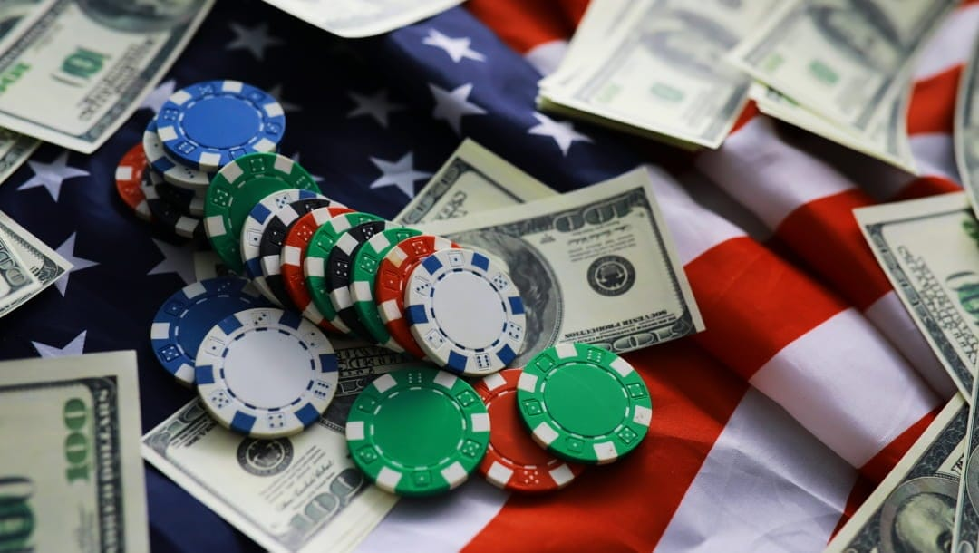
Is Gambling Sinful?
Majority of Americans say , “No.”
2001 – 62%
2025 – 57%

Slide 3
Gambling Defined:
Gambling: Betting of the outcome of a future event, when money or something of value is at stake on the outcome they predict.
When the outcome is settled, the winner collects the loser’s stakes
An uncertain event is arbitrarily determined
One risks money or something of value for chance to win more than what is being placed at risk
The winner wins at the expense of the loser.

Slide 4
Gambling violates Principles...
Love – seeking the well-being of others (Rom. 13:10. Gal.6 6:10)
Covetousness – feeds greed and addiction (Col. 3:5, Lk. 12:15, I Cor. 6:12)
Stewardship – faithful with what God has blessed us with (I Cor. 4:2, Lk. 12:42, I Pet. 4:10)
The “Golden Rule” – do unto others what you would they do unto you (Matt. 7:12)

Slide 5
Gambling Is Not...
Merely taking a risk... Driving a car, starting a business, operating a farm, investing in company’s stock – but no one must lose when you succeed. (Lk. 12:21)
Winning a prize in a sweepstakes... No bet is wagered on an uncertain outcome.
Receiving gain by chance is unrighteous? – Inheritance is by chance (Lk. 12:13-15)

Slide 6
Gambling Is...
The lottery...all who win do so at the expense of the losers.
Community raffle ticket ...when one wins, all other participants lose their wager.

