Slide 1
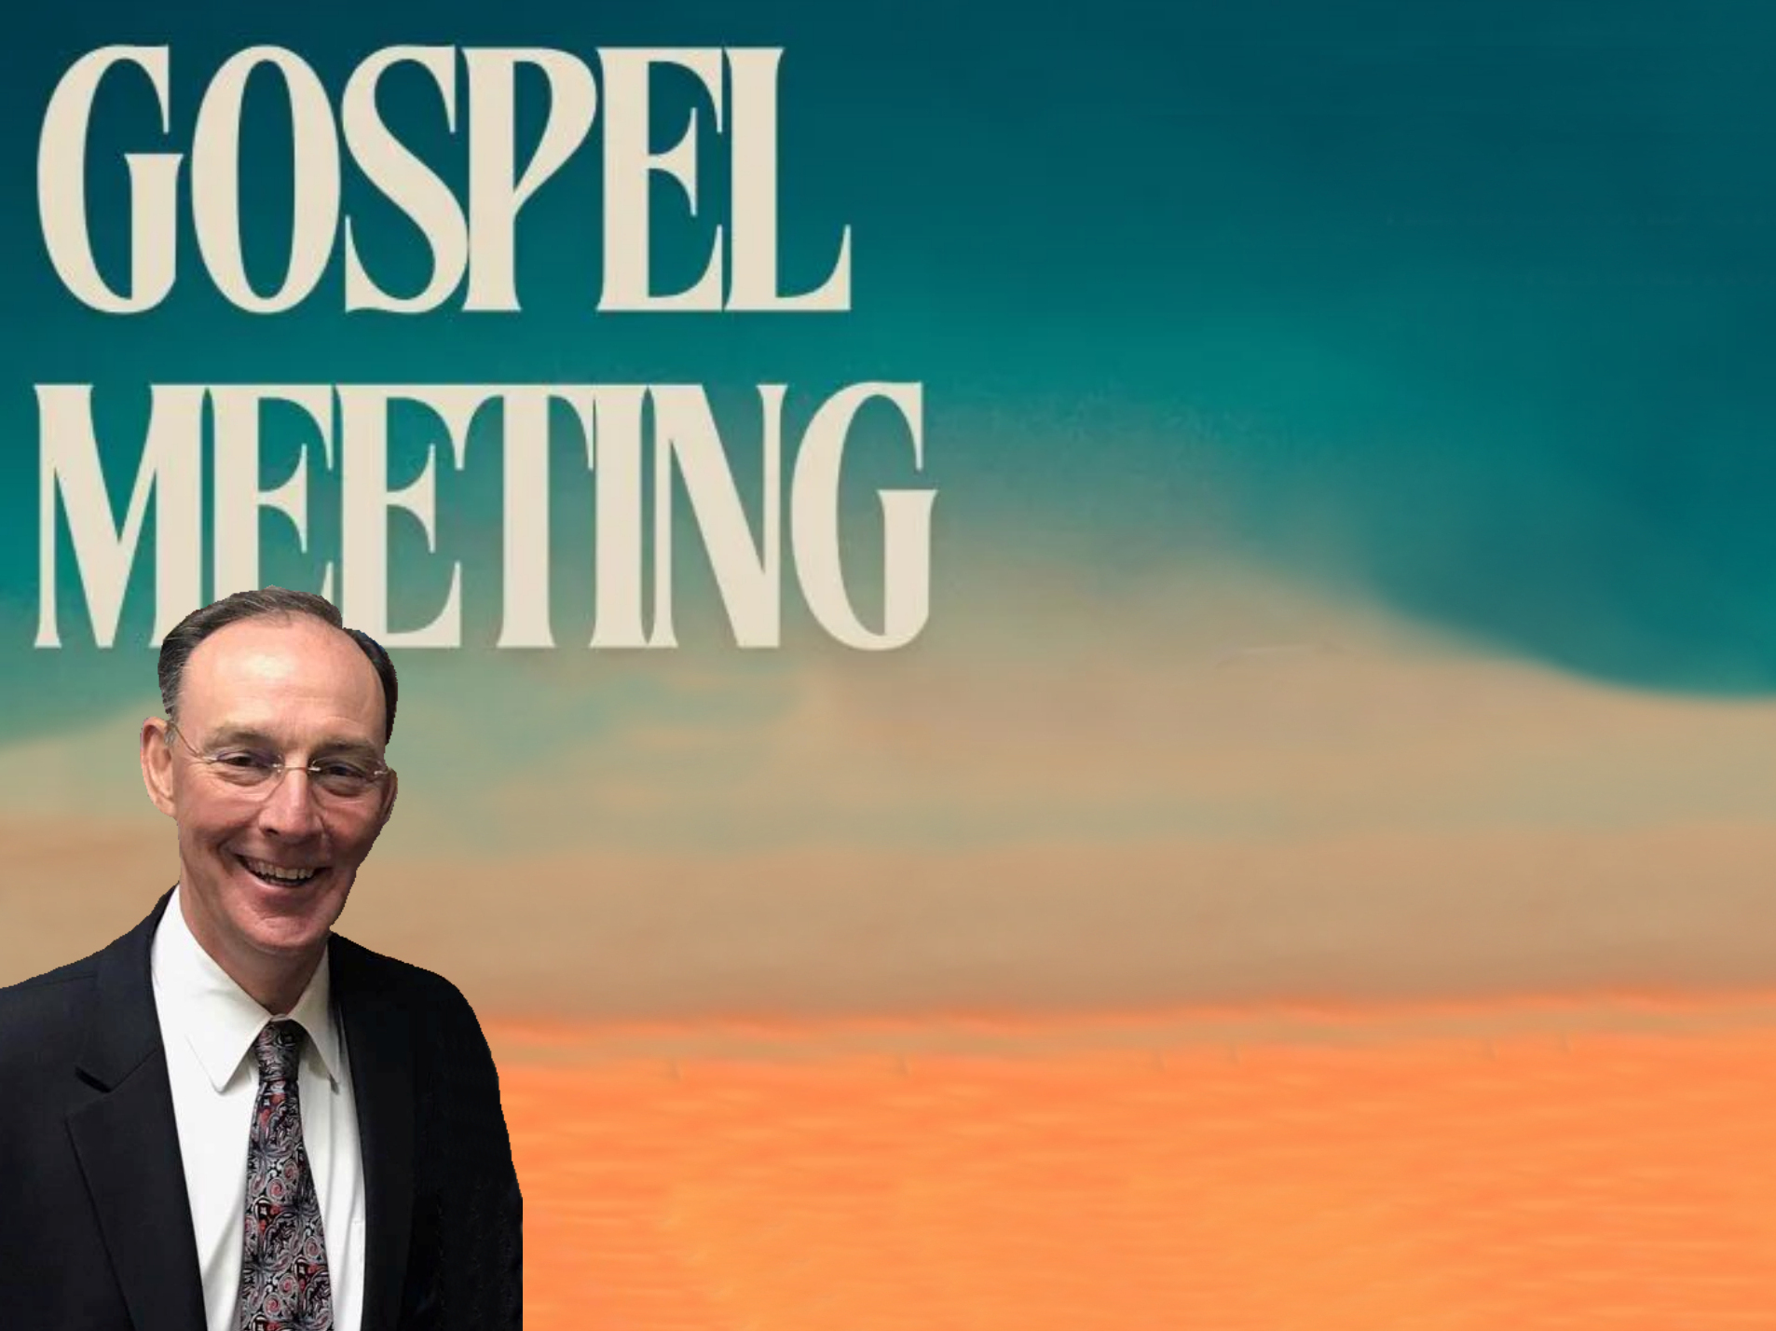
Inspiration of the Scriptures
Micky Galloway

Slide 3
THE INSPIRATION AND AUTHORITY OF THE SCRIPTURES
2 Timothy 3:16-17

Slide 4
What Is Inspiration?
Inspiration is: "A supernatural influence exerted on the sacred writers by the Spirit of God, by virtue of which their writings are given Divine trustworthiness" (B. B. Warfield, "Inspiration," Int. Stand. Bible Ency., p. 1473).

Slide 5
What Is Inspiration?
In defining scriptural inspiration three factors must be kept in mind:
(1) First, the primary efficient Cause, the Holy Spirit, who acts upon man; Cf. John 16:12-13; Matthew 10:19-20; Mark 13:11; Luke 12:12; Cf. 2 Peter 1:20-21
(2) Second, the subject of inspiration, man, the agent upon whom the Holy Spirit acts directly; Cf. 2 Peter 1:20-21; 1 Corinthians 2:12-13
(3) Third, the result of inspiration, a written revelation, given once for all, thoroughly accredited and tested by miracle and fulfilled prophecy Cf. Ephesians 3:3ff; Hebrews 2:2-3 (cf. J. E. Steinmueller, Companion to Scripture Studies [1941], 1:5, 14).

Slide 6
THE INSPIRATION OF THE SCRIPTURES
The claim of inspiration.
John 14:26; 16:13; 14:37; Galatians 1:12;
Ephesians 3:1-5; 1 Thessalonians 2:13; Revelation 1:1-2

Slide 7
THE INSPIRATION OF THE SCRIPTURES
Bible writers claimed to be speaking the word of God.
"Thus saith the Lord" or equivalent occurs over 2,000 times in the Old Testament alone.
Isaiah 1:1-2; Jeremiah 10:1-2; Ezekiel 1:3

Slide 8
THE INSPIRATION OF THE SCRIPTURES
The Bible is verbally inspired.
-1 Corinthians 2:10-13 - The apostles spoke the things of God using words which the Spirit of God (the Holy Spirit) taught them to use.
-2 Samuel 23:2 - David said that “the Spirit of the Lord spake by me....”
-Jeremiah 1:9 - When God appointed Jeremiah to be a prophet, He put His words in Jeremiah's mouth (not merely His ideas into Jeremiah's mind).
-Jeremiah 36:4 - Jeremiah dictated "all the words of Jehovah" which were then written upon a roll of a book.
-Acts 1:16 - Scripture was spoken by the Holy Spirit by the mouth of God's prophets (such as David, in this instance,
cf. Matthew 22:43).

Slide 9
THE INSPIRATION OF THE SCRIPTURES
The process of inspiration is summed up in Zechariah 7:12:
God sent His word By His Spirit By His prophets To His people

Slide 10
THE INSPIRATION OF THE SCRIPTURES
God's inspired scriptures are incorruptible - 1 Peter 1:22-25.
Inspired scripture completely equips a person to do God's will - 2 Timothy 3:16-17.

Slide 11
THE INSPIRATION OF THE SCRIPTURES
Scripture is the authoritative word of God –
John 10:35; 1 Corinthians 14:37.
Bible inspiration is supported by its unity and fulfilled prophecy - Isaiah 42:8-9; Deuteronomy 18:20-22; Luke 24:44-45.
THE BIBLE IS THE INSPIRED WORD OF GOD!

Slide 12
THE INSPIRATION OF THE SCRIPTURES
The Bible Claims to Be the Complete Revealed Will of God to Man.
A. Jesus promised that the Spirit would guide the apostles into ALL truth (John 14:26; 16:13).
B. The Holy Spirit came upon the apostles on the day of Pentecost as recorded Acts 2. God's will was revealed "unto his holy apostles and prophets in the Spirit" (Ephesians 3:5; cf. 1 Corinthians 2:6‑16; 1 Peter 1:12).
C. They wrote it down in a "few words" which we may read and understand (Ephesians. 3:3.4).We are warned, "not to go beyond the things which are written" (1 Corinthians 4:6; cf. 2 John 9).

Slide 13
THE INSPIRATION OF THE SCRIPTURES
D. The apostle Paul said: "according to that which is written, I believed, and therefore did I speak" (2 Corinthians 4:13).
E. He also stated that a man was "accursed" or "anathema" who taught "any gospel other than that which we preached" (Galatians 1:8,9; cf. I Timothy 1:3).
F. Peter asserts that God "hath granted unto us all things that pertain unto life and godliness (2 Peter 1:3);
G. Paul affirms that the scriptures furnish "completely unto every good work" (2 Timothy 3:17); and

Slide 14
THE INSPIRATION OF THE SCRIPTURES
H. Jude writes of the "faith which was once for all delivered unto the saints" (Jude 3).
  1. Concerning the phrase "once for all" in Jude 3, Thayer's Greek‑English Lexicon says: "used of what is so done as to be of perpetual validity and never need repetition" (p. 54).
  2. Therefore, the word of God is complete; there is no need for additional revelations; there are no latter-day revelations.

Slide 15
Galatians 1:6-7 “I marvel that ye are so soon removed from him that called you into the grace of Christ unto another (heteros, “different” ASV), gospel: Which is not another (allos) ; but there be some that trouble you, and would pervert the gospel of Christ.” (KJV)
Paul speaks of "a different gospel (heteros), which is not another" (allos, another like the one he preached), Gal 1:6-7. Allos expresses a numerical difference and denotes "another of the same sort"; Heteros expresses a qualitative difference and denotes "another of a different sort." (W.E. Vine)

Slide 16
THE INSPIRATION OF THE SCRIPTURES
The Bible says:
"Heaven and earth shall pass away, but my words shall not pass away" (Matthew 24:35.)
"the word of God . . . liveth and abideth forever" and that "the word of the Lord endureth forever" (1 Peter 1:23,25).
The Fact of Inspiration Stated. "Every scripture inspired of God (is) also profitable for teaching, for reproof, for correction, for instruction which is in righteousness. That the man of God may be complete, furnished completely unto every good work.” (2 Timothy 3:16-17)

Slide 17
THE INSPIRATION OF THE SCRIPTURES
Five great truths of inspiration taught:
1 Timothy 2:16-17
The verbal inspiration of the Bible, "all" or “every” (ASV);
The verbal inspiration specifically of the OT, plainly implying the entire NT as well, that is, "all Scripture";
The divine authorship of Scripture-"inspired by God" ("God-breathed");
The supreme value of all Scripture to the spiritual life, "profitable for teaching, for reproof, for correction, for instruction which is in righteousness";
The holy purpose of Scripture, "that the man of God may be complete, furnished completely for every good work."

Slide 18
The Nature of Inspiration.
2 Peter 1:20-21 “knowing this first, that no prophecy of scripture is of private interpretation. For no prophecy ever came by the will of man: but men spake from God, being moved by the Holy Spirit.”
First, it declares how it did not originate -it is not "a matter of one's own interpretation," that is, it is not the result of human research nor the product of the writer's own thought. It did not come into being by the will of man. Man did not propose to write it, decide its subject matter, or outline its arrangement.
Second, this passage tells how the Scriptures did originate. "Men," that is, certain divinely selected men, "spoke from God," the source. These inspired men were borne, or carried along, by the Holy Spirit, the message being His, not theirs.

Slide 19
Evidences of Inspiration.
The Unusual style of the Scriptures.
The brevity of entire books.
a. The book of Genesis has only fifty chapters, yet it tells of the origin of the world and all that is in it.
b. The first 2500 years of man’s history on earth is covered in these same chapters.
c. The first 34 verses tell of the creation of the material universe, the plant world, the animal world, and man.
d. To relate the life of Christ Matthew used 28 chapters, Mark used 16, Luke used 24 and John used 21.

Slide 20
Evidences of Inspiration.
The brevity of Bible incidents.
a. Genesis 3:1-24 tells the story of man’s fall.... origin of sin, suffering, sickness, death, toil, and the necessity of the coming of a Messiah.
b. The baptism of Jesus is described in Matthew 3:13-17. Mark and Luke also give brief accounts of this great event.
c. The transfiguration of Jesus is described in Matthew 17:1-8. Moses and Elijah coming back from the dead and the superiority of Christ in only eight verses.
d. The death of James the first apostle to be martyred is told in Acts 12:2. Only eleven words...
Men on their own do not write with such restraint.

Slide 21
Evidences of Inspiration.
The Unusual style of the Scriptures..
The omissions of the Scriptures.
The apostle John told of only twenty different days of the Lord’s life and ministry. The total life of Christ covered more than 12,000 days, and His active ministry more than 1270 days, yet all of the gospel narratives together tell of events which happened on only some 34 different days in the life of Christ. Out of the 879 verses in the gospel of John, 237 pertain to one day of Jesus’ life. ... Cf. John 20:30-31; Cf. Esp. John 21:25
b. The book of Acts tells of events in the lives of Peter and Paul... What about the other apostles?
c. What about the trial of Paul before Nero....?

Slide 22
Evidences of Inspiration.
The Unusual style of the Scriptures..
The impartiality of the Scriptures.
a. The writers of the Bible set forth both the virtues and the follies of those of whom they wrote.
b. Abraham and Sarah... Genesis 12:10-20; 20:1-12.
c. David... 2 Samuel 11:1-21
d. James and John (Anger toward the Samaritan village
Luke 9:51-55); Cf. Matthew 20:20-28.
e. Peter’s denial Matthew 26:69-75 and his hypocrisy
Galatians 2:11-14.

Slide 23
Evidences of Inspiration.
The Unusual style of the Scriptures..
The calmness of the Scriptures.
a. Christ’s miracles...
(1) Feeding the 5,000 Mark 6:39-44.
(2) Walking on the water Mark 6:49-51.
(3) Raising Lazarus John 11:43-46.
b. Christ in Gethsemane told without anger. Matthew 26:14-16, 47- 56.
c. Christ’s crucifixion is described without emotion. Matthew 27:33- 56.
d. Christ’s resurrection is pictured without the colorful adjectives that men would normally use. John 20:11-20.
All this without the adjectives: amazing, unbelievable, unprecedented…

Slide 24
Evidences of Inspiration.
The Unity of the Scriptures.
1. Sixty-six books of the Bible, written by about 40 different men, over a period of nearly 1600 years.
2. Men from different countries, speaking different languages, from different backgrounds, yet they present one central theme, without variation or contradiction.
  a. Many of these had no access to the other books of the Bible dealing with events of their own time, yet they wrote in perfect unity, each complementing what the others had written.
  b. Compare this to the writings of other religious writers.. (Book of Mormon, Writings of the Watchtower, etc...)
Unguided men could not have written with this degree of unity.

Slide 25
THE INSPIRATION OF THE SCRIPTURES
2 Tim. 3:16-17

Slide 26
Evidences of Inspiration.
Fulfilled Prophecies
1. Prophecy is not a guess, a forecast, a calculation, a mere conjecture, a vague generalization or an educated analysis of a forthcoming situation.
  a. Weather forecasters predict with about 60% accuracy.
  b. In Bible prophecy 100% must come to pass. Fulfillment is the acid text. (Deut. 18:9-22; Isa. 41:22-23)
2. What is prophecy? A forth-teller as well as a foreteller.
Cf. Ex. 7:1; 4:16

Slide 27
SPECIFIC PROPHECIES AND THEIR FULFILLMENT...
Israel in prophecy...
a. To receive a certain land (Gen. 15:18; Cf. Josh. 21:43ff; Neh. 9:7-8).
To lose the land (Deut. 4:25-26; Josh 23:14ff;
  Cf. 2 Kgs. 17:4-6; 24:10).
c. Remnant to be restored (Deut. 30:1-10; After 70 years Jer. 29:10-14; Cf. 2 Chron. 36:23; Ezra 1:3; 9:6-15).
  (1) To be released by Cyrus (Isa. 44:28-45:1).
All fulfilled.

Slide 28
SPECIFIC PROPHECIES AND THEIR FULFILLMENT...
Tyre in prophecy... Ezek. 26 (Ezekiel taken captive about 597 BC)
Strongholds to be destroyed (vs. 4).
Many nations to come up against her (vs. 3).
Dust to be scraped until bare as the top of a rock (vs. 4).
Ruins provide place for spreading of nets (vs.5).
Ruins of city to be dumped in the water (vs. 12,19).
To be desolate and uninhabited, never rebuilt (vs. 14,19).

Slide 29
SPECIFIC PROPHECIES AND THEIR FULFILLMENT...
Tyre in prophecy... Ezek. 26 (Ezekiel taken captive about 597 BC)
All Fulfilled:
Mainland Tyre besieged and destroyed by Nebuchadnezzar in 585-572.
Island city destroyed by Alexander the Great in 332 BC. Built causeway from ruins of mainland city.
Today fishermen dry their nets on the Causeway... Mainland Tyre never has been rebuilt.

Slide 30
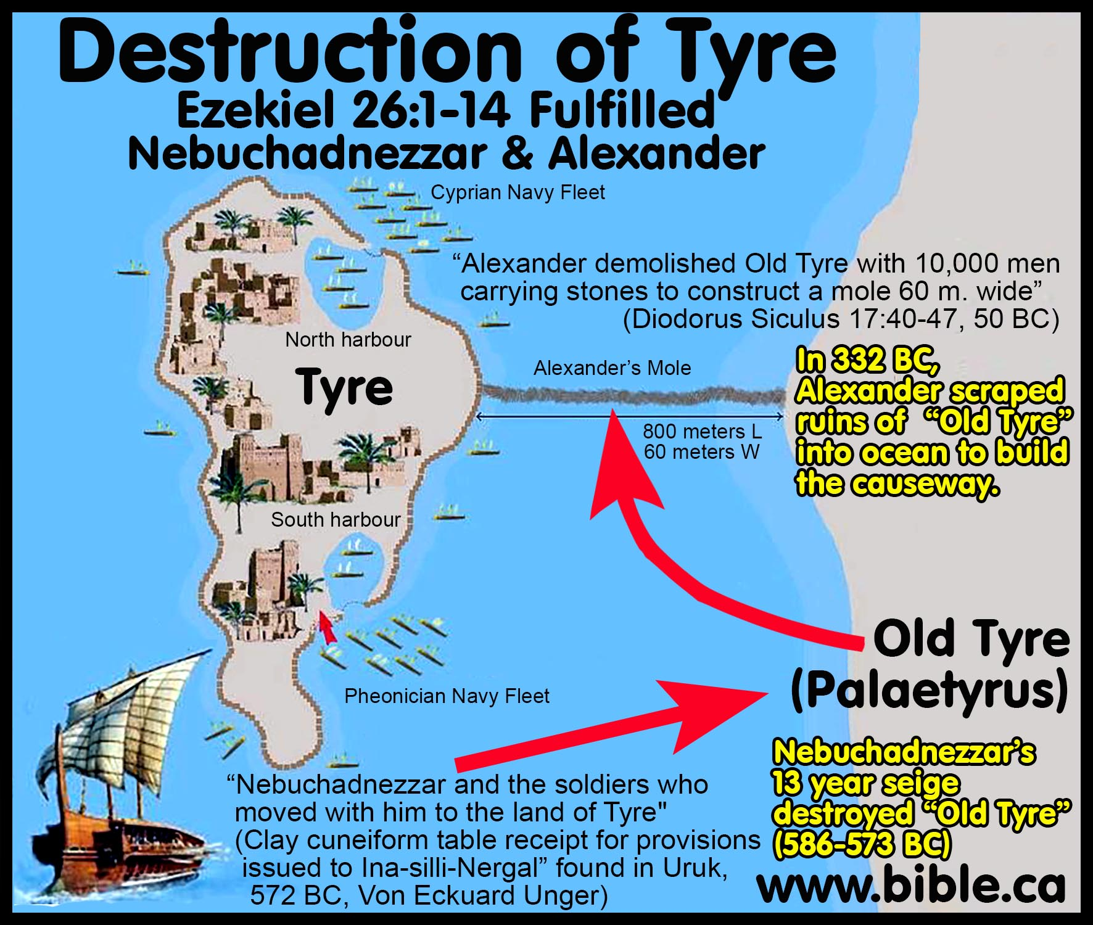

Slide 31
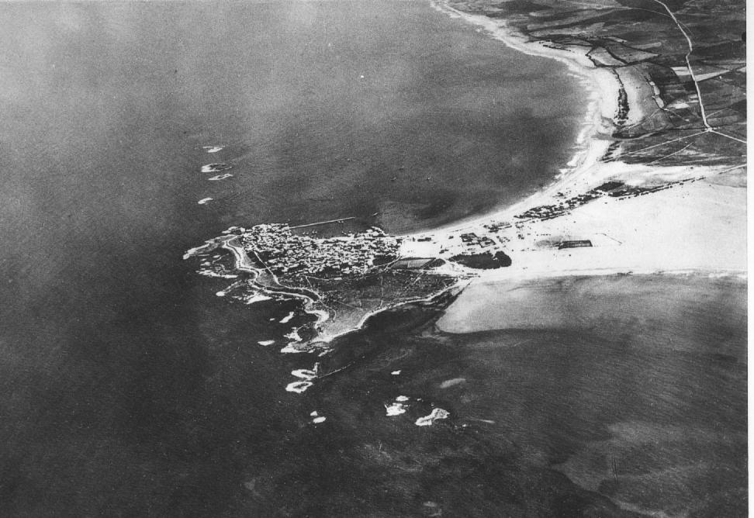
Aerial photo of Tyre made by France air force before 1934. File:Tyre-aerial-photo-by-France-Military-1934.jpg, (Public Domain)

Slide 32
SPECIFIC PROPHECIES AND THEIR FULFILLMENT...
Ninevah in prophecy... Isa. 10:12-14 (740-700 B.C.); Zeph. 2:13-15 (c. 625 B.C.); Nahum, (c. 625-612 B.C)
To be captured when its rulers were drunken (Nahum 1:10; 3:11)
Destruction to be total (Nah. 1:9).
Flooding of the river to be a factor (Nah. 1:8; 2:6).
Fire associated with destruction (Nah. 2:13; 3:13).
Shepherds to bring flocks there (Zeph. 2:14).
Those passing would hiss and wag the hand in amazement
(Zeph. 2:15).

Slide 33
SPECIFIC PROPHECIES AND THEIR FULFILLMENT...
Ninevah in prophecy...
Fulfilled:
Ninevah fell in 612 B.C. Empire fell in 605 B.C. under Babylonians.
High flooding eroded the walls of the city.
The Babylonian Chronical says the victors “carried off much spoil from the city and temple-area and turned the city into a ruin-mound and heap of debris...” Cf. Nah. 1:9
Today shepherds graze their sheep on the ruins of this ancient world capital.

Slide 34
SPECIFIC PROPHECIES AND THEIR FULFILLMENT...
Babylon in Prophecy. Isa. 13:17-22 (740-700 B.C.); Jer. 50-51 (627-585 B.C.)
Medes to completely overthrow. (Isa. 13:17-19).
Never to be inhabited (Isa. 13:20-22; Jer. 51:26).
Arab refuse to pitch his tent there (Isa. 13:20).
Wild beast to lie down there (Isa. 13:21-22).
City to become as heaps (Jer. 51:37).

Slide 35
SPECIFIC PROPHECIES AND THEIR FULFILLMENT...
Babylon in Prophecy.
Fulfilled
Cyrus the Mede-Persian captured Babylon (539 B.C. Cyrus Cylinder records the conquest – Discovered in 1879).
Babylon has not been inhabited for more than 2,000 years.
The Arab does not yet pitch his tent there.
Shepherds do not bring their flocks there.
Wild beast live where kings and queens once walked.

Slide 36
THE INSPIRATION OF THE SCRIPTURES
2 Timothy 3:16-17

Slide 37
CHRIST IN PROPHECY
The Prophecies of Christ may be categorized as follows:
Prophecies of his birth... fulfillment.
Prophecies of his character... fulfillment.
Prophecies of his ministry... fulfillment
Prophecies of his betrayal, trial and crucifixion... fulfillment.
Prophecies of his resurrection and exaltation... fulfillment.

Slide 38
PROPHECIES OF CHRIST'S BIRTH AND THEIR FULFILLMENT.
Born of the "seed of woman." (Genesis 3:15; Cf. Galatians 4:4; 3:16)
The seed of Abraham. (Genesis 12:1-3; 22:17-18)
Of the "tribe of Judah." (Genesis 49:8-9)
Of the lineage of David. (Psalms 132:11; 2 Samuel 7:11-14)
"A son is given." (Isaiah 9:6)
Born of "a virgin" (Isaiah 7:14; cf. Matthew 1:18-23; Luke 1:26-35)
Born in Bethlehem Ephratha. (Micah 5:2; cf. Joshua 19:5; Cf. Matthew. 2:1-6)

Slide 39
PROPHECIES OF CHRIST'S CHARACTER AND FULFILLMENT.
Described as "lowly". Isaiah 42:1-4; 53:7; Zechariah 9:9;
Cf. Matthew 21:1-5
"I am meek and lowly in heart." Matthew 11;29; Cf. Philippians 2:5; 2 Corinthians 8:9

Slide 40
PROPHECIES OF CHRIST'S MINISTRY... AND FULFILLMENT
The forerunner John the Baptist, was set forth as one "that crieth in the wilderness," preparing "the way of the Lord." (Isa. 40:3-5; Matthew 3:3)
Before the Savior comes, one will come who will tell you that He shortly will come. (Cf. Malachi 3:1; 4:5;
Matthew 11:7-15; Mark 9:11-13; Luke 1:17)
Specific prophecies of His ministry.
  Jesus' service to the down trodden. (Isaiah 42:5-7; Luke 4:18)
  His ministry to the Gentiles. (Isaiah 42:1-4; Matthew 12:21)
  He would teach in parables. (Psalms 78:2; Mark 4:33-34)

Slide 41
PROPHECIES OF CHRIST’S BETRAYAL, TRIAL AND CRUCIFIXION... AND FULFILLMENT. Dates: David, c. 1,000 B.C.; Isaiah, 740-700 B.C.; Zechariah, c. 520 B.C.
He was to be betrayed by a friend. Psalms 41:9; 55:13.
Sold for 30 pieces of silver. Zechariah 11:12-13; Matthew 27:3-10
  Even this money would be cast to the potter. Zechariah 11:13; Matthew 27:3-10
He would be deserted by his disciples. Zechariah 13:7; Matthew 26:56
He would be mocked and insulted. Psalms 35:15-16 and yet through it all he would remain silent. Isaiah 53:7; Matthew 27:12-14,39,41,43

Slide 42
PROPHECIES OF CHRIST’S BETRAYAL, TRIAL AND CRUCIFIXION... AND FULFILLMENT. Dates: David, c. 1,000 B.C.; Isaiah, 740-700 B.C.; Zechariah, c. 520 B.C.
His hands and feet were to be pierced. Psalms 22:16; Luke 23;33; John 21:25,27
He was to be given vinegar and gall to drink. Psalms 69:21; Matthew 27:34
He was to die with the wicked. Isa. 53:9; Matthew 27:38
He was to be nailed to the cross, but no bones were to be broken. Psalms 22:16; 34:20; John 19:36

Slide 43
PROPHECIES OF CHRIST’S BETRAYAL, TRIAL AND CRUCIFIXION... AND FULFILLMENT. Dates: David, c. 1,000 B.C.; Isaiah, 740-700 B.C.; Zechariah, c. 520 B.C.
His garments to be parted and lots cast. Psalms 22:18; John 19:24
He was to cry, "My God, My God, why hast thou forsaken me?"
Psalms 22:1; Matthew 27:46
His side to be pierced. Zechariah 12:10; John 19:34, 37
To be buried in a rich man's tomb. Isaiah 53:9; Matthew 27:57-60

Slide 44
HOW DO YOU EXPLAIN WITHOUT INSPIRATION?
NOTE: There are numerous prophecies fulfilled in one 24-hour period surrounding the death of Christ.
These prophecies were written up to 1,000 years or more before the time of their fulfillment.
They had all been translated from Hebrew into Greek nearly 300 years before their fulfillment.
Many of them were fulfilled by the enemies of Christ who would not knowingly fulfill a single verse of Scripture.

Slide 45
“How could uninspired man write a book that commands all duty, forbids all sin, including the sin of hypocrisy and lying, denounces all human merit as insufficient for salvation, holds out as man’s only hope faith in the atoning death, physical resurrection, and present intercession of Christ, and condemns to hell for all eternity all who reject this one way of salvation and persist in sin?” (Dr. Henry Thiessen, Introduction to the New Testament; Grand Rapids, Mich.: Wm. B. Eerdmans Publishing Co., 1950, p. 85).

