Slide 1

Christ lives in me
as I die to self
Galatians 2:20

Slide 2
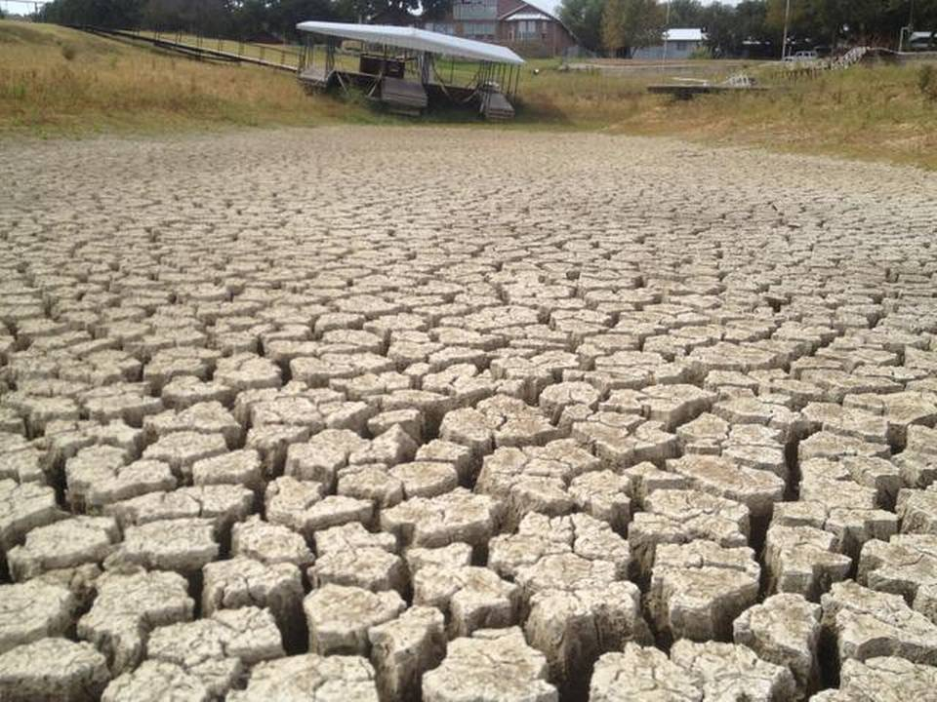
Lake Mineral Wells, Texas

Slide 3
Why do we need a savior?
Luke 24:25 “Beginning at Moses and all the prophets…”
Psalm 8:4 “Who is man that Thou art mindful of him…”
Eph 1:3 Every spiritual blessing in the heavenlies.
Eph 1:19 Power worked in Christ…in the heavenlies.
Eph 2:6 To sit together in the heavenlies… in Christ
Eph 3:10 “… wisdom of God…by the church…”
Eph 6:12 “…wrestle against …rulers of darkness…”

Slide 4
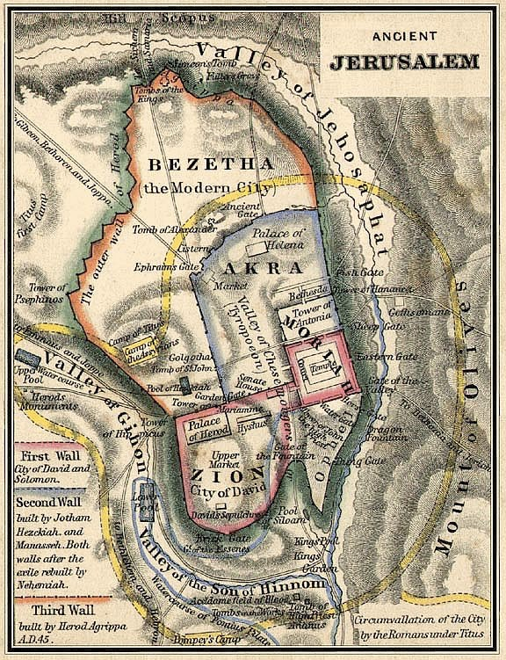
We live in a parallel universe.
2 Kings 6:16
Mt 7:13 Jesus spoke more about hell than heaven
Mk 9:43 The opposite of eternal life is eternal death.
Jo 14:1-3 We are invited to share paradise with Him.
Ro 3:23 “all sin & fall short Ro 6:23 wages of sin is death”

Slide 5
Jesus offers cleansing, He offers life.
Jo 6:44 Yes but HOW does Jesus “draw” all people
Jo 12:31 By His sacrifice for all people upon the cross
Is 43:4 “He has born our griefs and carried our sorrows
Acts 2:41 God “added” them
Jo 1:1 “In the beginning….”
Gen 3:14 prophesied satan would have his head crushed

Slide 6
But the fulness of Christ IN us…
1 Jo 1:ff This is an all encompassing connection. 1 Jo 2:5 “By this we know that we are IN Him 1 Jo 2:24 “let that abide in you…” 1 Jo 2:15 “do not love the world…” 1 Jo 3:1 “You are children of God… purified…” 1 Jo 3:7 “… righteous as He is righteous…” 1 Jo 3:10 Love we show for others reflects His love for us. 1 Jo 4:6 We need to be “of” God. 1 Jo 4:9 “Live through Him…” 1 Jo 4:12 He who abides in love abides in God & God abides in him 1 Jo 5:11 Have “eternal life, and that life in the Son. 1 Jo 5:13 that you may KNOW that you have eternal life. 1 Jo 5:18 Know the truth

Slide 7
Christ, all else is rubbish
Gal 1:6 “I marvel you are so soon removed from Him…”
2 Pet 1:20 “no scripture is of any private interpretation.”
Gal 4:12 “you know me…” “you love me”
1 Cor 11:18 “when you come together in the church..”
2 Pet 2:1 a false teacher is one that teaches something false
Acts 20:28 Who is the bigger fool?
Jer 5:31 “a horrible thing…the people love it so…”
2 Tim 4:10 “Demas…having loved this present world…”

Slide 8
The fulness of Christ
Eph 2:11 Without Him…
“A lot of people are interested in having Christ be their Savior but few people are interested in having Christ as their Lord.”
Luke 2:11 “For to YOU is born to YOU this day…”

Slide 9


The fulness of Christ
Without Him I would
Lake Mineral
Wells Texas
“Without Him I would be dying”

Slide 10
The fulness of the Christian in Him
Col 2:10 “In whom you are made full.”
Eph 3:19 “…that you may be filled unto all the fulness of God”
Ezek 36:25 Finding our own shortcomings loathsome and an abomination.
Phil 1:21 “To live is Christ, to die is gain”

