Slide 1
Sin
God
Dead to Sin
Alive to God
Christianity
Husband, Wife, Children
Honor, Obedience Taxes
Family
Government
Jesus: “My yoke is easy and My burden is light” (Matt. 11:29-30)

Slide 2
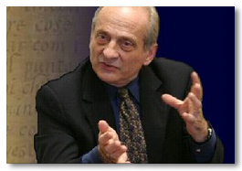

“Religion takes a good deal of time, not just on Sunday mornings; the serious practice of any religion calls for much more than that. There are other church services, as well as time for prayer and Scripture reading, not to mention time for ‘good works’ of various sorts. I was far too busy for such time-consuming activities” (pp., 136-137).
Paul Vitz
Heb. 10:24-25
Acts 20:7
I Thess. 5:17
2 Tim. 2:15
Matt. 5:16

Slide 3
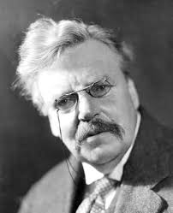
“The Christian ideal has not been tried and found wanting. It has been found difficult; and left untried.”
G. K. Chesterton

Slide 4
Disciples: John 6:52-54,60
⁵² The Jews therefore strove one with another, saying, How can this man give us his flesh to eat?
⁵³ Jesus therefore said unto them, Verily, verily, I say unto you, Except ye eat the flesh of the Son of man and drink his blood, ye have not life in yourselves.
⁵⁴ He that eateth my flesh and drinketh my blood hath eternal life: and I will raise him up at the last day.
Hard saying because of misunderstanding the saying
⁶⁰ Many therefore of his disciples, when the heard this, said, This is a hard saying; who can hear it?

Slide 5
Disciples: John 6:63, 67-68
Hard saying because of misunderstanding the saying
⁶³ It is the spirit that giveth life; the flesh profiteth nothing: the words that I have spoken unto you are spirit, are life.
⁶⁷Jesus said therefore unto the twelve, Would ye also go away?
⁶⁸Simon Peter answered him, Lord, to whom shall we go? thou hast the words of eternal life.
Not too difficult to understand…

Slide 6
Jesus: John 3:19-21
¹⁹ And this is the judgment, that the light is come into the world, and men loved the darkness rather than the light; for their works were evil.
²⁰ For every one that doeth evil hateth the light, and cometh not to the light, lest his works should be reproved.
²¹ But he that doeth the truth cometh to the light, that his works may be made manifest, that they have been wrought in God.
Men do not come to the light because they love the darkness - not that they have proven the illusion of the light

Slide 7
Paul: Ephesians 4:17-20
¹⁷ This I say therefore, and testify in the Lord, that ye no longer walk as the Gentiles also walk, in the vanity of their mind,
¹⁸ being darkened in their understanding, alienated from the life of God, because of the ignorance that is in them, because of the hardening of their heart;
¹⁹ who being past feeling gave themselves up to lasciviousness, to work all uncleanness with greediness.
²⁰ But ye did not so learn Christ
Warning: Ignorance of world often rises from hard hearts, not convincing evidence against Christianity.

Slide 8
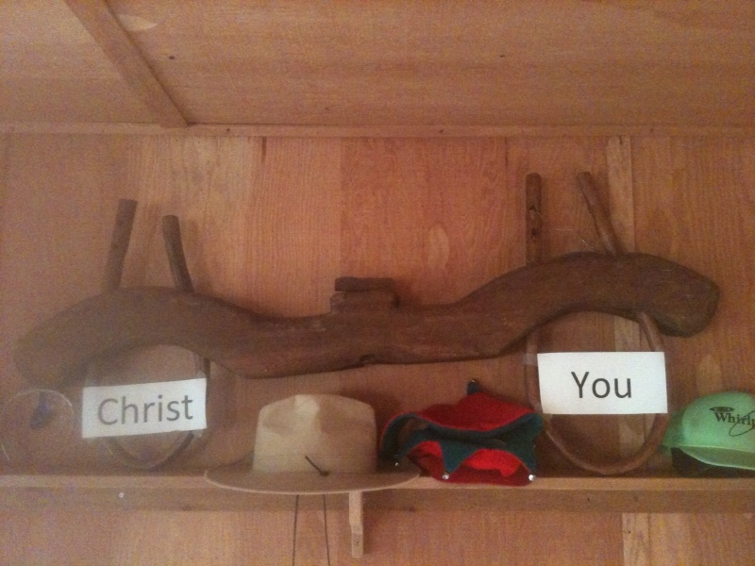
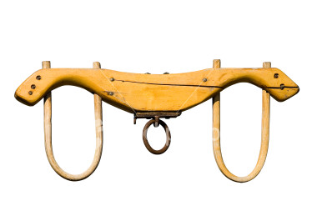
I Peter 2:3 “Tasted that the Lord is gracious” Eph. 2:5
2 Corinthians 4:17 “light affliction” Rom. 8:18
My Yoke is Easy…
My Burden is light
Matthew 11:29-30

Slide 9
You and The Sin Problem
IS IT TOO DIFFICULT…
To be BAPTIZED FOR THE REMISSION OF SINS (Acts 2:38) ?
To develop a RENEWED MIND - GROW (Rom. 12:2, 2 Pet. 3:18) ?
To CONFESS, REPENT, PRAY for Forgiveness ( I Jn.1:9, Acts 8:21-22)?

Slide 10
Christianity is Demanding - Not Too Difficult
STUDENT
Late nights and Hard Study
Success in life
ATHLETE
Strenuous Training, long practices
Championship
Press on – stretching forward (Phil. 3:13-14)
Goal - Prize of the High Calling
CHRISTIAN
Difference lies in Setting Your Priority

