Slide 1
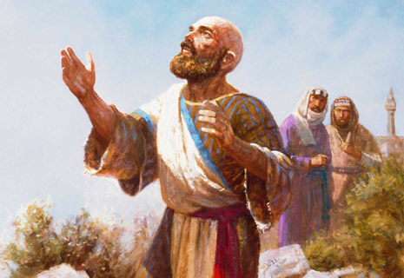
Did Job Sin?
“Wherefore I abhor myself, and repent in dust and ashes”
Job 42:6

Slide 2
Did Job Sin?
“Wherefore I abhor myself, and repent in dust and ashes”
How We Should React to Suffering in Faith
Job 42:6

Slide 3
Did Job Sin?
Not when he lost his substance, servants and ten children in one day (Job 1:22)
Not when smote with boils from foot to crown (Job 2:10)

Slide 4
Did Job Sin?
Not when Eliphaz implies Job’s sins as being the reason for his suffering (Job 4:7-9; 5:8,17; 6:10; 15:20)

Slide 5
Did Job Sin?
Not when Eliphaz implies Job’s sins as being the reason for his suffering (Job 4:7-9; 5:8,17; 6:10; 15:20)
Not when Bildad cruelly suggests Job’s children’s death and job’s continued misery are the result of transgression (8: 3-7; 9:22-24, 10:1-2; 6-7; 18:5)

Slide 6
Did Job Sin?
Not when Eliphaz implies Job’s sins as being the reason for his suffering (Job 4:7-9; 5:8,17; 6:10; 15:20)
Not when Bildad cruelly suggests Job’s children’s death and job’s continued misery are the result of transgression (8: 3-7; 9:22-24, 10:1-2; 6-7; 18:5)
Not when Zophar suggests Job to put sin far away and misery will be far removed (11:14-16; 12:1-2,13:3-19; 20:5)

Slide 7
Did Job Sin?
Eliphaz’s brutal accusations of sin (22:5-11; 23:1-6)
Bildad’s brief attempt to drive Job to admit his sin that God can see the inward man (25:1-6; 27:1-5)
Zophar is silent!

Slide 8
Did Job Sin?
Eliphaz’s brutal accusations of sin (22:5-11; 23:1-6)
Bildad’s brief attempt to drive Job to admit his sin that God can see the inward man (25:1-6; 27:1-5)
Zophar is silent!
Elihu speaks against words of three friends, and Job (32:11-14; 33:8-12; 37:5-15)

Slide 9
Job Repents in Ashes – 42:6
Job’s sin:
In upholding his own integrity, Job as crossed the line in “condemning God” (40:8)

Slide 10
Job Repents in Ashes – 42:6
Job’s sin:
In upholding his own integrity, Job as crossed the line in “condemning God” (40:8)
Is God considering Job His “enemy” (33:10, 13:24)

Slide 11
Job Repents in Ashes – 42:6
Job’s sin:
In upholding his own integrity, Job as crossed the line in “condemning God” (40:8)
Is God considering Job His “enemy” (33:10, 13:24)
Wanting to prove his innocence before God, after months of suffering, job fails to see the love and grace of God that is present in his suffering (Cf. 2 Cor. 12: 7-9)

Slide 12
Job’s Growing Faith
Job curses the day of his birth (3:1-3)
The grave (sheol) no longer to return (7:9-10)
Go into the grave – dark as midnight (10:20-22)
Shall he live again? (14:7-14)
My Redeemer liveth (19:25-27)

