Slide 1
Dwelling with God
Exodus 25:8
“And let them construct a sanctuary for Me, that I may dwell among them.

Slide 2

God seeks to dwell with His people
In the garden
(Gen. 3:8)

Slide 3
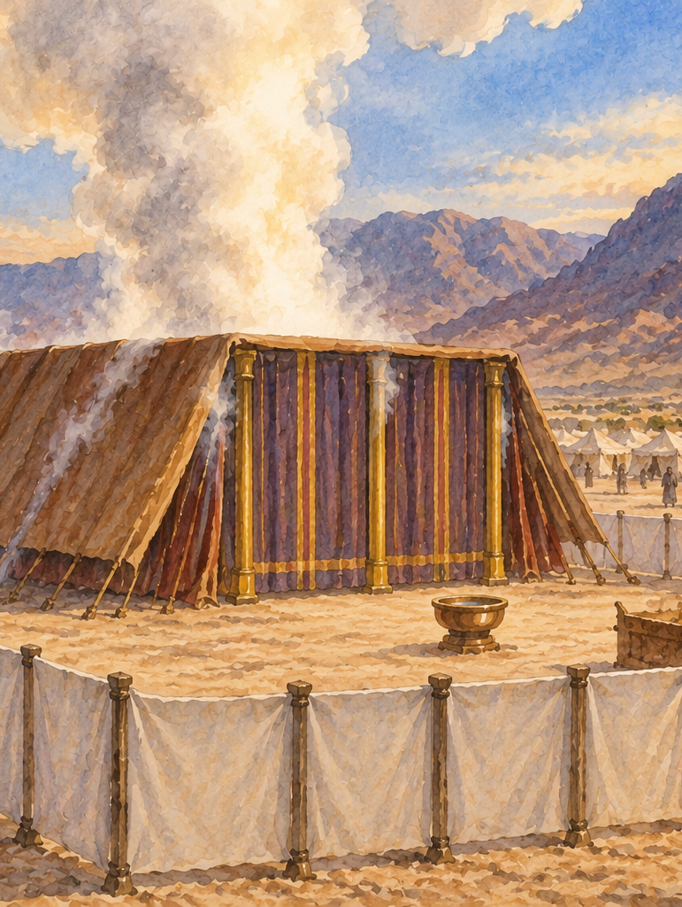
God seeks to dwell with His people
In the garden
(Gen. 3:8)
In the Tabernacle
(Ex. 25:8, Ex. 40:34-35)

Slide 4
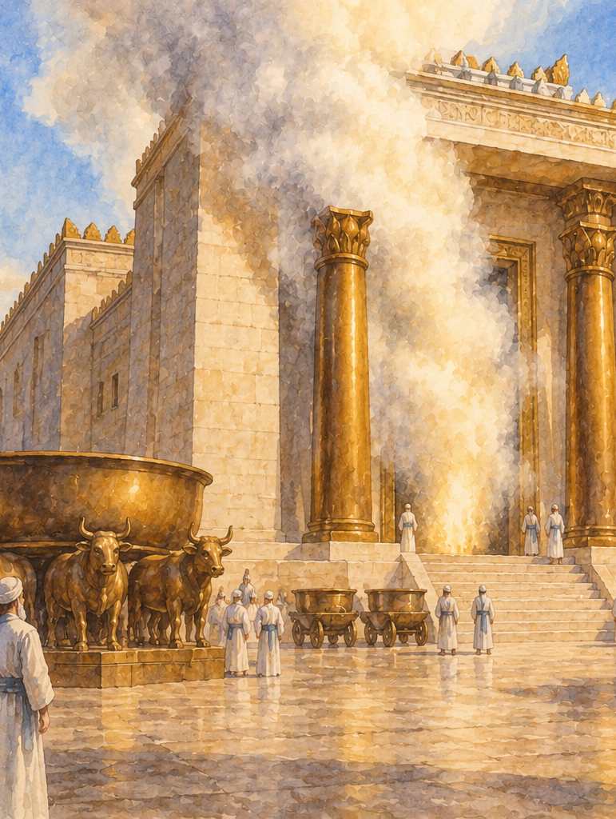
God seeks to dwell with His people
In the garden
(Gen. 3:8)
In the Tabernacle
(Ex. 25:8, Ex. 40:34-35)
In the Temple
(2 Chron. 5:13-14)

Slide 5

Ezekiel: Prophet in Babylonian Captivity
597 BC – 2nd Deportation
593 BC – Ezekiel begins ministry
586 BC – Jerusalem/Temple destroyed
573 BC – Ezekiel receives vision of great Temple
Prophetic ministry begins (Eze. 1:1-5, 13-17, 26)
Abominations committed in the Temple (Eze 8:6-18)
Glory of God leaves in judgement (Eze 10:18-19, 11:22-23)
God is not bound by location:
  The wicked had deluded themselves into feeling safe (Eze. 11:1-2,11-13)
  God is the sanctuary of the faithful (Eze. 11:14-20)
  The New Temple of God (Eze. 40-48, 22:26, 44:23)
  God’s eternal dwelling place (Eze. 43:6-7)

Slide 6
God seeks to dwell with His people
Haggai prophesied of a greater temple (Hag. 2:1-9)
Immanuel – God with us (Is. 7:14, Mt. 1:21-23)
Physical manifestation in Christ (Jn. 1:14)
  “Dwell” – Greek means literally “To fix one’s tabernacle”
  “We beheld His glory, glory as of the only begotten from the father, full of grace and truth.”

Slide 7
God seeks to dwell with His people
In the church
  The church is now God’s temple (1 Cor. 3:16-17)
    “You” – plural
  Not to be used for immorality (1 Cor. 6:18-19)
  Christ is the cornerstone (Eph. 2:20-22)
  Not a physical kingdom (Heb. 12:22-29)
    “Offer to God an acceptable service with reverence and awe.”
In the individual
  With those who love Him and keep His word (John 14:23)

Slide 8
God desires to dwell with His people.
Sin cannot coexist with God’s holy presence.
God now dwells in His church, and in His people
Therefore, we must treat God’s dwelling place as holy.

