Slide 1
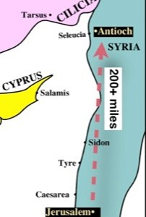

Slide 2
Acts 11:21
Rom 5:15, Eph. 2:8
God’s Grace already in place...Jesus
Hand of the Lord was with them
Speaking the Word Preaching the Lord Jesus
Acts 11:19-20
Great Number Believed; Great number turned to the Lord; Much people added to the Lord Much people taught;
Acts 11:21, 24, 26
The church in Antioch was flourishing…
Acts 11:19-30
ERROR CAME TALKING... Acts 15:2, 24

Slide 3
Pattern for Correction…
Begins with God…His authoritative Word (2 Tim. 3:16)
His Harmonious – Confirming Word (Acts 15: 9-11, 12, 15-18)
His Demanding Word (Acts 15:28-29)
His joy-producing Word (Acts 15:31)
His Universal Word (Acts 15:23, 30, 16:4)
His Faith-Strengthening Word (Acts 16:5)

Slide 4
Acts 11:21
Rom 5:15, Eph. 2:8
God’s Grace already in place...Jesus
Hand of the Lord was with them
Speaking the Word Preaching the Lord Jesus
Acts 11:19-20
Great Number of Believed; Great number turned to the Lord; Much people added to the Lord Much people taught;
Acts 11:21, 24, 26
The church in Antioch was flourishing…
Acts 11:19-30
ERROR CAME TALKING... Acts 15:2, 24
The Word of God came Correcting !

