Slide 1
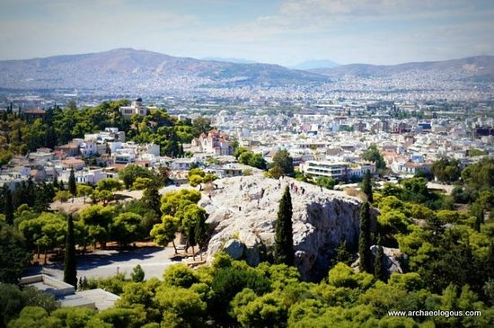
Find Meaning… Seek God
Acts 17:27
Pagan Culture - Athens
God – Creator 0f all things (v.24)
We are the Offspring of God (28-29)
God – Needs Nothing From Man – Gives life to All (v.25)
Preached Jesus and Resurrection (v.18, 30-32)
God – of one made all nations (v.26)

Slide 2
God – Jesus – Salvation
Sin – fall short of the Glory of God (Rom. 3:23)
Grace – When dead in sin God saved us (Eph. 2:1-4)
Love – God so loved that He gave His Son (Jn 3;16)
Draws Us – God through the Gospel (Jn. 6:44-45, 2 Thess. 2:13-14)
Gospel – Death, Burial Resurrection of Jesus – (I Cor. 15: 1-4, Acts 17:31)
Saving Response (Acts 2: 41,47)

Slide 3
Christ – the Meaning of the Bible
Seed of Woman vs. Satan (Gen.3:15)
Promise to Abraham –his Seed – Nations Blessed (Gen. 12:3)
Salvation - Gospel (Gal. 3:8)
Baptized Into Christ – (Gal. 3:26-29)

Slide 4

The Meaning of Life:
“Fear God and Keep His Commandments….And Receive Salvation in His Son ”

