Slide 1


GOD-CENTERED
NOT MAN-FOCUSED

Slide 2
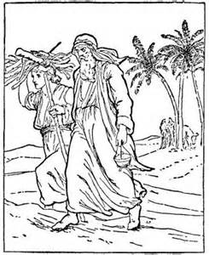
GOD-CENTERED
NOT MAN-FOCUSED
Tested

Slide 3
GOD-CENTERED
NOT MAN-FOCUSED
Affirm That God Tests Us!

Slide 4

GOD-CENTERED
NOT MAN-FOCUSED
1 Thessalonians 2:4 - But as we have been approved by God to be entrusted with the gospel, even so we speak, not as pleasing men, but God who tests our hearts.

Slide 5
TESTED OR TEMPTED?
Satan Tempts With Intent That We Fail By Sinning (Mat.4:1-3)
God Tests Desiring Us To Succeed Thus Be Approved (Gen.22:12)

Slide 6
WHY ARE WE TESTED?
Proves Our Faith
Hebrews 11:17-19; Genesis 22:1-18; Deuteronomy 8:1-6
Strengthens Spiritually
1 Peter 1:6-7; James 1:2-4
Example For Others
James 5:10-11; 1 Peter 2:20-24

Slide 7
HOW ARE WE TESTED?
Automatically Happens When God Commands - Either Obey Or Reject! e.g. Mk.16:16; Heb.5:9
Need To Test Ourselves
2 Cor.13:5; James 1:22-25

