Slide 2
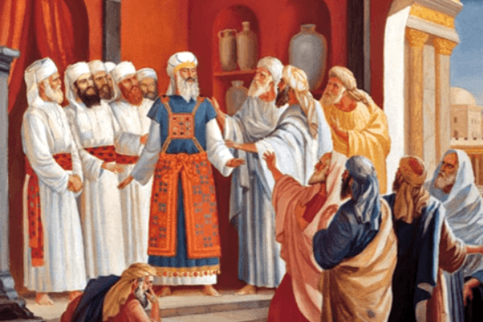
And the Lord spoke to Moses, saying: “Bring the tribe of Levi near, and present them before Aaron the priest, that they may serve him. And they shall attend to his needs and the needs of the whole congregation before the tabernacle of meeting, to do the work of the tabernacle.
The High Priest with the Levitical Priesthood – Serving the People before God
Numbers 3:5-7

Slide 3
Jesus is our High Priest today...
Hebrews 2:17-18
We can therefore draw near to God today....
Hebrews 10:19-20
The Law contained the shadow of the good things to come... Heb. 10:1-18
The second covenant (Law)
The remission of sins
We can draw near with confidence having such a great High Priest

Slide 4
What Should Happen... Heb. 10:21-25
We should draw near with confidence, having a cleansed heart –true heart in fullness of faith (v. 21-22)
  Heart sprinkled clean by the blood of Christ – conscience deep (Heb. 9:14)
  When: we submit our body to be immersed in water – baptism (Rev. 1:5, Acts 22:16, I Cor. 6:11, Heb. 10:14)
  Baptism is the moment we enter into Christ with confidence (Gal. 3:26-27)
  No longer having to wonder – when did I really get saved?

Slide 5
What Should Happen... Heb. 10:21-25
We should hold fast to our hope which we confess... (v. 23)
  Jesus is our hope – heaven is God’s promise (Heb. 3:1, I Tim. 1:1, Titus 1:2, I Pet. 1:1-3)

Slide 6
What Should Happen... Heb. 10:21-25
We should consider one another – to motivate unto love and good works (v. 24-25)
  Not forsaking our assembling together... But exhorting one another
  Proclaim good tidings of righteousness in the great assembly (cf. Psm. 40:8-10, Psm. 22:22-23, Heb. 2:11-12)

