Slide 1
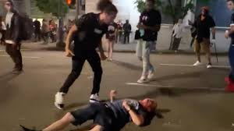
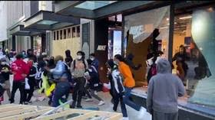
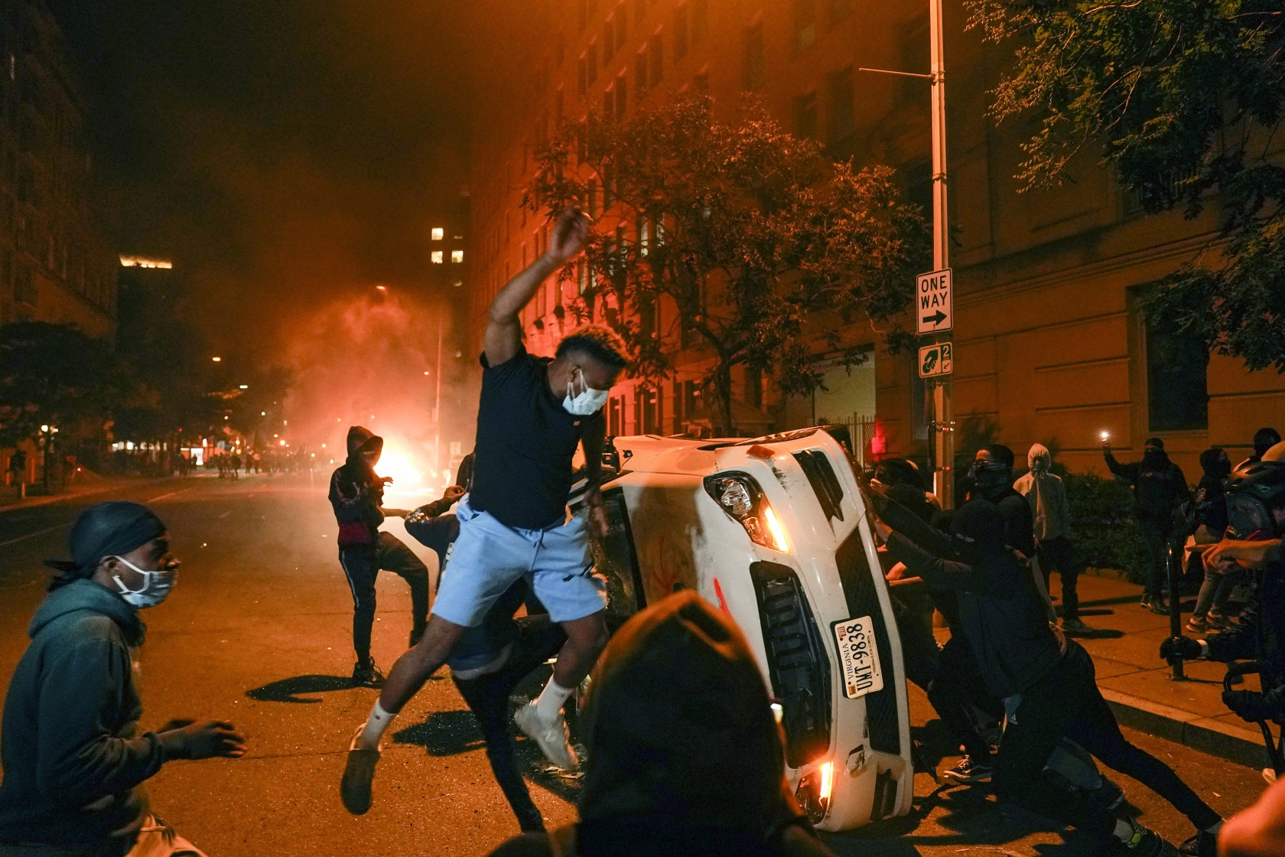
How do you like the chaos?

Slide 2
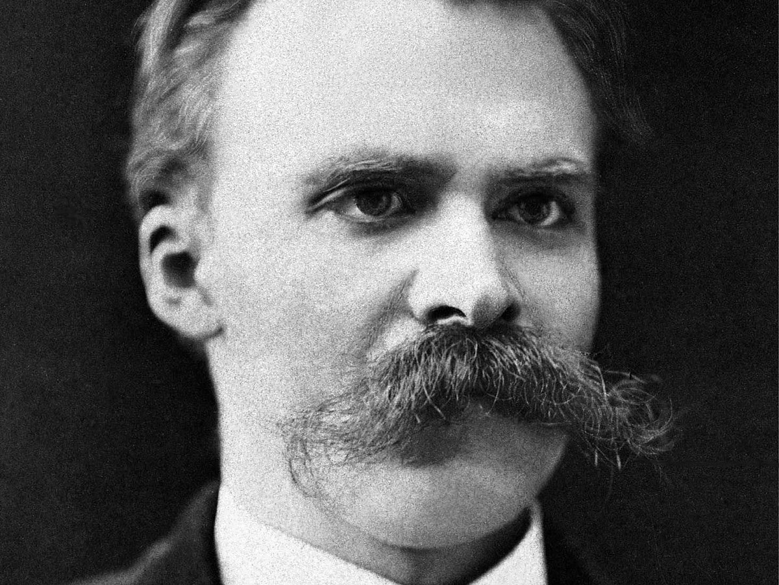
“I am still too pious that even I worship at the altar where God’s name is truth.”
Friedrich Nietzsche
1844-1900
“The real truth about ‘objective truth’ is that the latter is a fiction. Every candidate for truth must first be expressed in language, and language is notoriously unable to get us to reality. Words, like a hall of mirrors, reflect only each other and in the end point to the condition of their users, without having established anything about the way things really are. Truth is the name we give to that which agrees with our own instinctive preferences. It is what we call our interpretation of the world, especially when we want to foist it upon others.”

Slide 3

Nihilism…
extreme skepticism maintaining that nothing in the world has a real existence.

Slide 4

Panel Surveys among America’s ≥18 years old
June 24–30, 2020.
The percentage of respondents who reported having seriously considered suicide in the 30 days before completing the survey (10.7%)…
was significantly higher among respondents aged 18–24 years (25.5%)…
self-reported unpaid caregivers for adults§ (30.7%), and essential workers (21.7%).
The suicide rate for people ages 10 to 24 increased by 56% between 2007 to 2017, according to the CDC.
5, 412 completed survey

Slide 5
Post Modernism is Not New…
Just another way to replace God with Self – Question objective Truth (Gen. 3:1-3, 6)
Effects are the same: - Marred the way before God and violence filled the earth (Gen. 6:11-12)
Continues to repeat itself … Judges 19:22-26, 21:25, Prov. 16:2, 25

Slide 6
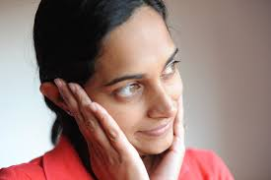
OBJECTIVE TRUTH – JESUS CHRIST
SUBJECTIVE TRUTH – “AS YOU SEE IT”
New Testament is “inclusive…”
I Am the Way- Truth- Life (Jn. 14:6)
Homosexuality – Episcopal Church
My spoken word will judge you in the last day (Jn. 12:47-48)
Spirit of Truth (Holy Spirit) will Guide you (Apostles) in all the truth (Jn. 16:13)
“I could argue that the overwhelming emphasis on the inclusion in the New Testament trumps the two or three passages from St. Paul that may condemn homosexuality…” William Barnwell
God’s Revealed Word is Truth that will set you apart from the World (Jn. 17:17)

Slide 7
“And be not fashioned according to this world; but be ye transformed by the renewing of your mind, that ye may prove what is the good and acceptable and perfect will of God” (Rom. 12:2)
  CERTAINTY
MEANING
Death – Judgment (Heb. 9:27)
TRUTH
“Inclusiveness” has boundaries (I Tim. 2:4,6, Rom. 1:16, Mk. 16:16)
Hope… I Pet. 1:3-4

