Slide 1
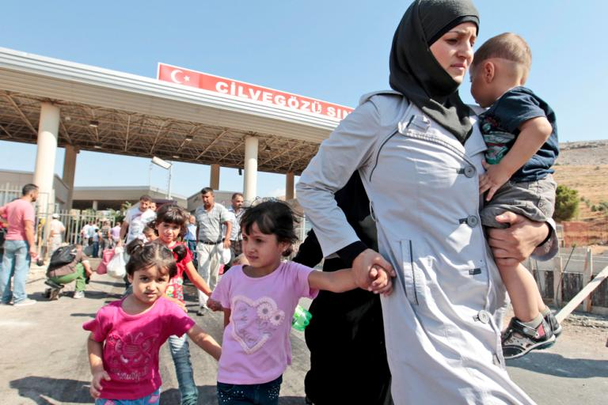
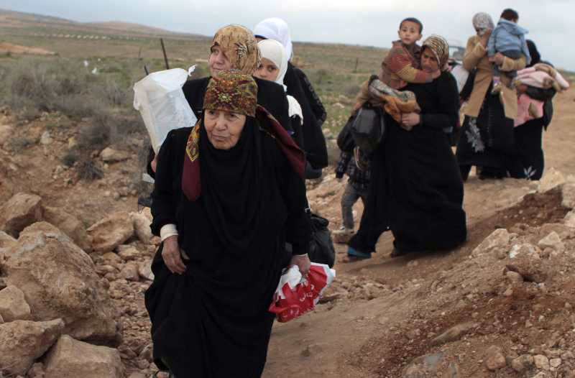
How Do You View The Syrian Refugees?

Slide 2
How Do You View The Syrian Refugees?
The Sojourner in God’s View

Slide 3
God’s Attitude Toward The Sojourner
He loves and provides for them (Deut. 10:18)

Slide 4
God’s Attitude Toward The Sojourner
He loves and provides for them (Deut. 10:18)
Deserving of access to Justice (Num. 35:15)

Slide 5
Viewing the Sojourner with God
We are to love the sojourner like God does (Deut. 10:19)

Slide 6
Viewing the Sojourner with God
We are to love the sojourner like God does (Deut. 10:19)
We are to love the sojourner as ourselves (Lev. 19:34)

Slide 7
Viewing the Sojourner with God
We are to love the sojourner like God does (Deut. 10:19)
We are to love the sojourner as ourselves (Lev. 19:34)
Who is my neighbor?- the ones in need whom I can help (Lk. 10:25-37)

Slide 8
Viewing the Sojourner with God
We are to love the sojourner like God does (Deut. 10:19)
We are to love the sojourner as ourselves (Lev. 19:34)
Who is my neighbor?- the ones in need whom I can help (Lk. 10:25-37)
God is working in such times (Deut. 2:26-31, Ruth 1:1,16)

Slide 9
Viewing the Sojourner with God
We are to love the sojourner like God does (Deut. 10:19)
We are to love the sojourner as ourselves (Lev. 19:34)
Who is my neighbor?- the ones in need whom I can help (Lk. 10:25-37)
God is working in such times (Deut. 2:26-31, Ruth 1:1,16)
Such crisis should be viewed as an opportunity for the saving Gospel of Christ (Acts 8:3-4)

Slide 10
Christ is the Answer
Peace with God – Peace with one another (Eph. 2:13-21)

Slide 11
Christ is the Answer
Peace with God – Peace with one another (Eph. 2:13-21)
We all can become united in being sojourners and pilgrims in God’s kingdom (I Pet. 2:11, Phil. 3:20-21)

