Slide 2
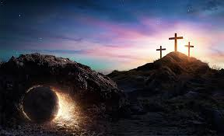
What If There Were No Resurrection?

Slide 3
The Atheist would...
still have to deal with physical death... Alexander the Great – died June 10, 323 B.C. at the age of 32.
still be separated from his or her wealth...cannot buy or sell your gold, drive your expensive cars, wake up in your luxurious house. (I Tim. 6:7)
still have to deal with not being remembered... (Ecclesiastes 2:15-16)

Slide 4
The Old Testament Believer would...
know God as “Creator” (Genesis 1:1, 2:7)
know God as “Judge” (Ecclesiastes 11: 9, 12:13-14)
Know God as “Receiver” of his or her spirit at the point of death (Ecclesiastes 12:7)
Look toward being vindicated by a living God...seeing him after body destroyed (Job 19:25-26)

Slide 5
The New Testament Christian would...
Know that “Christ has not been raised”
Know that ” preaching” is vain
Know that “faith” is vain (I Corinthians 15:13)
Know that we are “yet in our sins” (I Corinthians 15:17)

Slide 6
But we know Christ has been raised bodily from the dead...
Eye - witness accounts (I Cor. 15:5-8, Luke 24:36-43)
Christ is the “first fruits” ( I Cor. 15:20-23)
Know we will have a “glorified body” (Phil. 3:20-21; I Cor. 15:42-44)
We have a “living hope” beyond the grave (I Peter 1:3-5, Titus 1:2)
With confidence can invite you to come to Christ for remissions of sins and hope of eternal life in heaven (cf. Col. 2:12)

