Slide 2
Is the Bible Truly From God ?
Jesus Fulfilled Prophecy – Foundation for Our Faith
T

Slide 3
“...but when the fulness of the time came, God sent forth his Son, born of a woman, born under the law, that he might redeem them that were under the law, that we might receive the adoption of sons. Galatians 4:4-5

Slide 4
And he said unto them, O foolish men, and slow of heart to believe in all that the prophets have spoken! Behooved it not the Christ to suffer these things, and to enter into his glory? And beginning from Moses and from all the prophets, he interpreted to them in all the scriptures the things concerning himself. Luke 24:25-27

Slide 5
“...and Paul, as his custom was, went in unto them, and for three sabbath days reasoned with them from the Scriptures, opening and alleging that it behooved the Christ to suffer, and to rise again from the dead; and that this Jesus, whom, said he, I proclaim unto you, is the Christ.” Acts 17:2-3

Slide 6
Matt. 2:5-6
Matt. 3:10
Matt. 21:4-5
Psm. 41:9, Jn. 13:18
Matt. 26:14-16
Matt. 27:3,7
Matt. 27:12-14
Jn. 20:25-27
Prophecy | Detail | Probability
Micah 5:2 | Born in Bethlehem | 1 in 280,000
Malachi 3:1 | Forerunner... | 1 in 1000
Zechariah 9:9 | Entered Jerusalem as King – on colt | 1 in 10,000
Zechariah 13:6 | Betrayed by Friend Wounded “Hands” | 1 in 1000
Zechariah 11:12 | Betrayed for 30 Pieces of silver | 1 in 10,000
Zechariah 11:13 | 30 Pieces of silver Returned - Purchase | 1 in 100,000
Isaiah 53:7 | Trial – No Defense | 1 in 10,000
Psalm 22:16 | Crucified | 1 in 10,000
1 in 10¹⁷

Slide 7


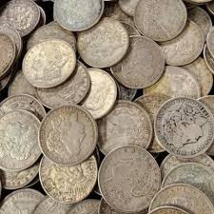
1 in 100,000,000,000,000,000
One Hundred Quadrillion
1017 silver dollars would cover Texas 2 feet deep...

Slide 8
Over 300 Old Testament Prophecies were fulfilled in Jesus
Probability of just 48 of prophecies being fulfilled in one person? 1 in 10¹⁵⁷
10,000,000,000,000,000,000,000,000,000,000,000,000,000,000,000,000,000,000,000,000,000,000,000,000,000,000,000,000, 000,000,000,000,000,000,000,000,000,000,000,000,000,000, 000, 000,000,000,000,000,000,000,000,000

Slide 9
Isaiah 52-53 Fulfilled in Jesus
Isaiah 52:13 High and lifted up, exalted 1 in 1.17 ×10⁹
Isaiah 52:14 Marred beyond human semblance 1 in 1,000
Isaiah 53:2 From a poor background 1 in 1.5
Isaiah 53:3 Despised and rejected 1 in 1.25
Isaiah 53:5 Crucified 1 in 100,000
Isaiah 53:7 Did not defend themselves while at trial 1 in 1,000
Isaiah 53:9 Buried in or near a rich man’s tomb 1 in 500
Isaiah 53:9 Innocent yet put to death 1 in 50

Slide 10

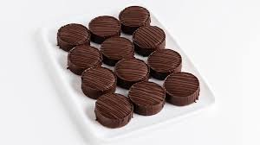
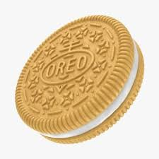
Probability 2.94 X 10¹⁴
4.44 cm. – diameter
0.798 cm thick
7% left over to start second roll
163, 695 sq. mi.

Slide 11
All Scripture is given by inspiration of God, and is profitable for doctrine, for reproof, for correction, for instruction in righteousness, that the man of God may be complete, thoroughly equipped for every good work. 2 Tim. 3:16-17

