Slide 1
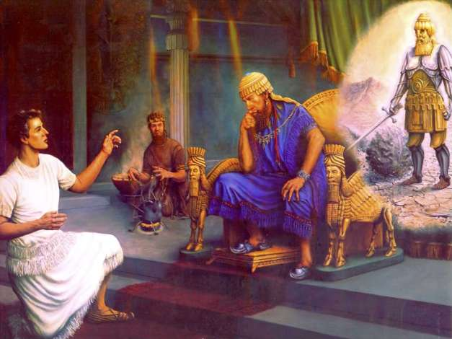
Wisdom
Knowledge
Understanding Science
(Dan. 1: 4)
Prove us... Pulse (vegetables) to eat and water to drink for days... (Dan. 1:12)
Refusend to defile himself,,, (Dan. 1:8)
Fairer and fatter(firmness) in flesh than the rest... (Dan. 1:15)

Slide 2
Proverbs... 1:1-6
The proverbs of Solomon the son of David, king of Israel: To know wisdom and instruction, To perceive the words of understanding, To receive the instruction of wisdom, Justice, judgment, and equity; To give prudence to the simple, To the young man knowledge and discretion— A wise man will hear and increase learning, And a man of understanding will attain wise counsel, To understand a proverb and an enigma,

Slide 3
Where Knowledge and Wisdom Begins...
The fear of the Lord is the beginning of knowledge, But fools despise wisdom and instruction – Prov. 1:7
The fear of the Lord is the beginning of wisdom, And the knowledge of the Holy One is understanding – Prov. 9:10

Slide 4
Wisdom Gained...
When Sinners entice... (Prov. 1:10-19)
When Sexually seduced... (Prov. 7: 4-23)
When Wine looks good... (Prov. 23: 29-35, 20:1)
Not overstaying our welcome... (Prov. 25:17)
Not building our house first... (Prov. 24:27)
In Correcting a Scoffer ( Prov. 9:7-9)

Slide 5
Wisdom Is Assessable and Appealing
She cries out ... (Prov. 8 : 1-11)
She has built her house – come in and enjoy (Prov. 9:6)

