Slide 2
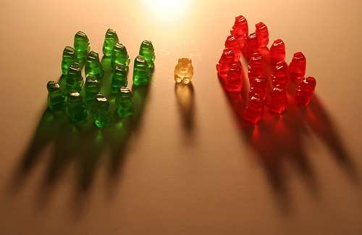
John 6
John 9
Jesus: No Middle Ground
John 10

Slide 3
John 6: After 5,000 Fed
“bread came down out of heaven” (v.32)
Murmured (v.41)
Belief – He has words of life … (v.68)
“I am the bread of life (v.35)
Strove – How can this man give us his flesh to eat (v.52)
“my flesh – eat and not die” (v.51)
Belief – He in Holy One of God (v.69)
Disciples – hard saying (v.60)
“Eat flesh of son of man drink blood” (v.53)
Many disciples walked no more with Him (v.66)
Words spoken are life (v.63)

Slide 4
John 9: Healing of Blind Man
Others: how can sinner do sign (v.16)
Neighbors: Verification of man (v.8-9)
Facts of Miracle (1-7)
Man – Jesus is a Prophet (v.17)
Pharisees: Jesus not of God (v.16)
Miracle done on Sabbath (v.14)
Man– God hears not sinners – Unique Miracle (v.32-33)
Pharisees: Jesus is a sinner (v.24)
Pharisees : Cast out man (v. 34)
Man – Worships Son of God (v.35-38)

Slide 5
John 10: The Parable of Sheep
Parable: Door, Sheep, Porter, Shepherd, Thief (v. 1-6)
Why? Give life abundantly (v.10)
Jews: Jesus has a demon – he is insane (mad) (v.19)
How? Give life – take it up again (v.17-18)
Jesus: “I am the door” (v.9)
Jesus: “I am the good shepherd (v.11)
Jews: Can a demon open the eyes of the blind? (v.21)
Jesus: Has sheep not of this fold – Gentiles (v.16)

Slide 6
John 6
John 9
Jesus: No Middle Ground
John 10

