Slide 1
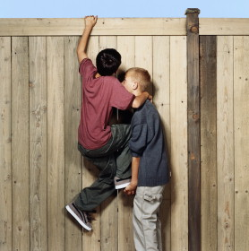
Perseverance of the Saints…Doing our Part
Hebrews 3:12-15

Slide 2
Our Part…
“Take Heed, brethren”: Constantly vigilant (v. 12)
  Evil heart can arise within a brother in Christ (Matt. 6:22-24, 5:28, Jms. 3:8-12)
  Unbelief can arise among God’s people (Heb. 3:18-19, 4:1-2,11)
  Saved brethren can fall away – “apostasy” (Heb. 6:4-8)

Slide 3
Our Part…
“exhort one another”: Constant encouragement (v. 13)
  Daily Activity (Acts 2:46, I Thess. 4:10, Heb. 13:19,22)
  Keep hardness of heart from developing – deceitfulness of sin (Prov. 23:29-35, Phil. 4:2, I Thess. 5:11)
  Do you have such gift? (Rom. 12:8)

Slide 4
Our Part…
“if we hold fast the beginning of our confidence firm unto the end” –proof of our being in Christ which already has started (v. 14-15)
  Perfect tense: “For we are become” – present state resultant from a past action
  Remember context – we can fall away from God – resulting in being lost
  We can persevere - “Hear His voice” (v. 15; 2 Pet. 1:10-11)

Slide 5
Constant vigilance…who needs my help?
Whom will I encourage TODAY?
Perseverance of the Saints…Doing our Part
No drop outs allowed

