Slide 1
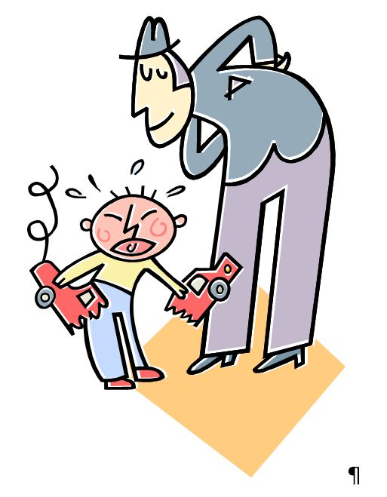
I have been Chastened… What Now?
Hebrews 12:12-17

Slide 2
The Pain and Suffering is not God’s HATRED – But His LOVE (Heb. 12:6)
God is not treating you as an ENEMY, but as a SON (Heb. 12:7)
The chastening is for OUR GOOD – DISCIPLINE- unto being sharers in God’s HOLINESS / RIGHTEOUSNESS (Heb. 12:10-11)

Slide 3
C
Chastened…What Now?
Heal in the right direction – Straight Paths (v. 12-13; Isa. 35:3-5)
  Encouraging others
  Self-Discipline
  Proper Healing
Follow after Peace with all men – but not when such takes you away from God’s holiness (v. 14, I Pet. 3:11-12, I Cor. 7:14-15, 22-24, Matt. 5:8)

Slide 4
C
Chastened…What Now?
Do not fall short of the “grace of God” - Become “bitter” (v. 15)
  Look Carefully among you
  Root of bitterness can spring up – Those not learning God’s grace in Chastening
  Affects others – many defiled

Slide 5
C
Chastened…What Now?
Do not depart from the way of holiness – Like Esau (Heb. 12:16-17, Gen. 25:27-34; 27:34-40)
  Do not turn back to the “fleshly mind “– fornicator (Gal. 5:17, Rom. 8:5-9)
  Do not turn back to the “profane mind” – no reverence for the sacred – Profane person
  For one mess of meat – Esau sold his birthright - holy things no longer have their high value in our lives.
  For what are you willing to trade Heaven?

Slide 6
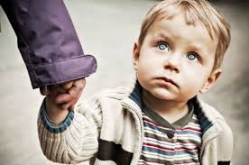
Heal in the right direction: Holiness!
Holiness with God takes precedence over peace with men!
Do not become Bitter and lead others away from the holiness of God!
Proper Reaction To God’s Chastening…
Do not leave the way of holiness and become profane!

