Slide 1

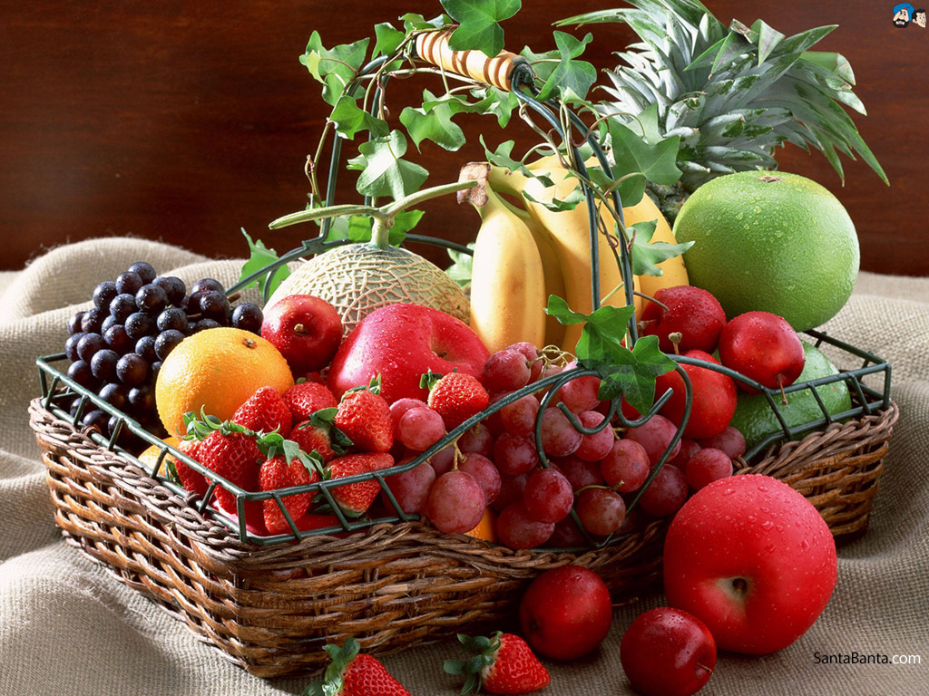
Self – Control (Gal. 5:23)
The Fruit Of The Spirit

Slide 2
“Temperance”
Self – Control

Slide 3
Self – Control in All things (I Cor. 9:25)
“Temperance”
Self – Control

Slide 4
Self – Control in All things (I Cor. 9:25)
“Temperance”
Self – Control
“The ability to restrain desire by reason when it is set on base enjoyments and pleasures…”
“take hold of” – Get A Grip

Slide 5
Sexual Desire (Acts 24:25, I Cor. 7:9)
Self – Control

Slide 6
Food and Drink (Prov. 23:1-8, 20-21)
Sexual Desire (Acts 24:25, I Cor. 7:9)
Self – Control

Slide 7
Food and Drink (Prov. 23:1-8, 20-21)
Sexual Desire (Acts 24:25, I Cor. 7:9)
Self – Control
Wrath -Anger (Gal. 5:20, Eph. 4:26, 31, Col. 3:8)

Slide 8
Food and Drink (Prov. 23:1-8, 20-21)
Sexual Desire (Acts 24:25, I Cor. 7:9)
Self – Control
Abound in -
Essential for Spiritual Leadership (2 Pet. 1:6-8, Titus 1:8)
Wrath -Anger (Gal. 5:20, Eph. 4:26, 31, Col. 3:8)

