Slide 2
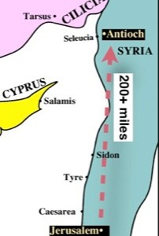
The church in Antioch
was flourishing…
Acts 11:19-30
Vigorous and Healthy Growth...

Slide 3
Antioch: a “Flourishing” church
“Speaking the Word – “Preaching the Lord Jesus” (Acts 11:19-20; cf. Acts 2:23-24, 34-36)
“Scattered” but not silent
To “Jew” and “Greeks”

Slide 4
Antioch: a “Flourishing” church
“Hand of the Lord was with them ...” (Acts 11:21)
“Great Number” of Believers...
“Turned to the Lord” - response to believing involves Repentance and Baptism (Acts 3:19, Acts 2:38, Acts 11:18, Acts 19:5)

Slide 5
Antioch: a “Flourishing” church
Work of Barnabas and Paul (Acts 11:22-26)
Could see the “grace of God”
Gladness and Exhortation – with purpose cleave to the Lord
“Much people added to the Lord”
Seeks Paul’s help – “taught much people”
“disciples” “called “Christians” first in Antioch” (Isa. 62:2)

Slide 6
o
Working: Speaking and preaching the Word
Pray that the hand of the Lord will be with us, (Col. 4:2)
Exhorting with Joy – “Cleave to the Lord”
The church in Antioch
was flourishing…
Acts 11:19-30
Vigorous and Healthy Growth...

