Slide 1
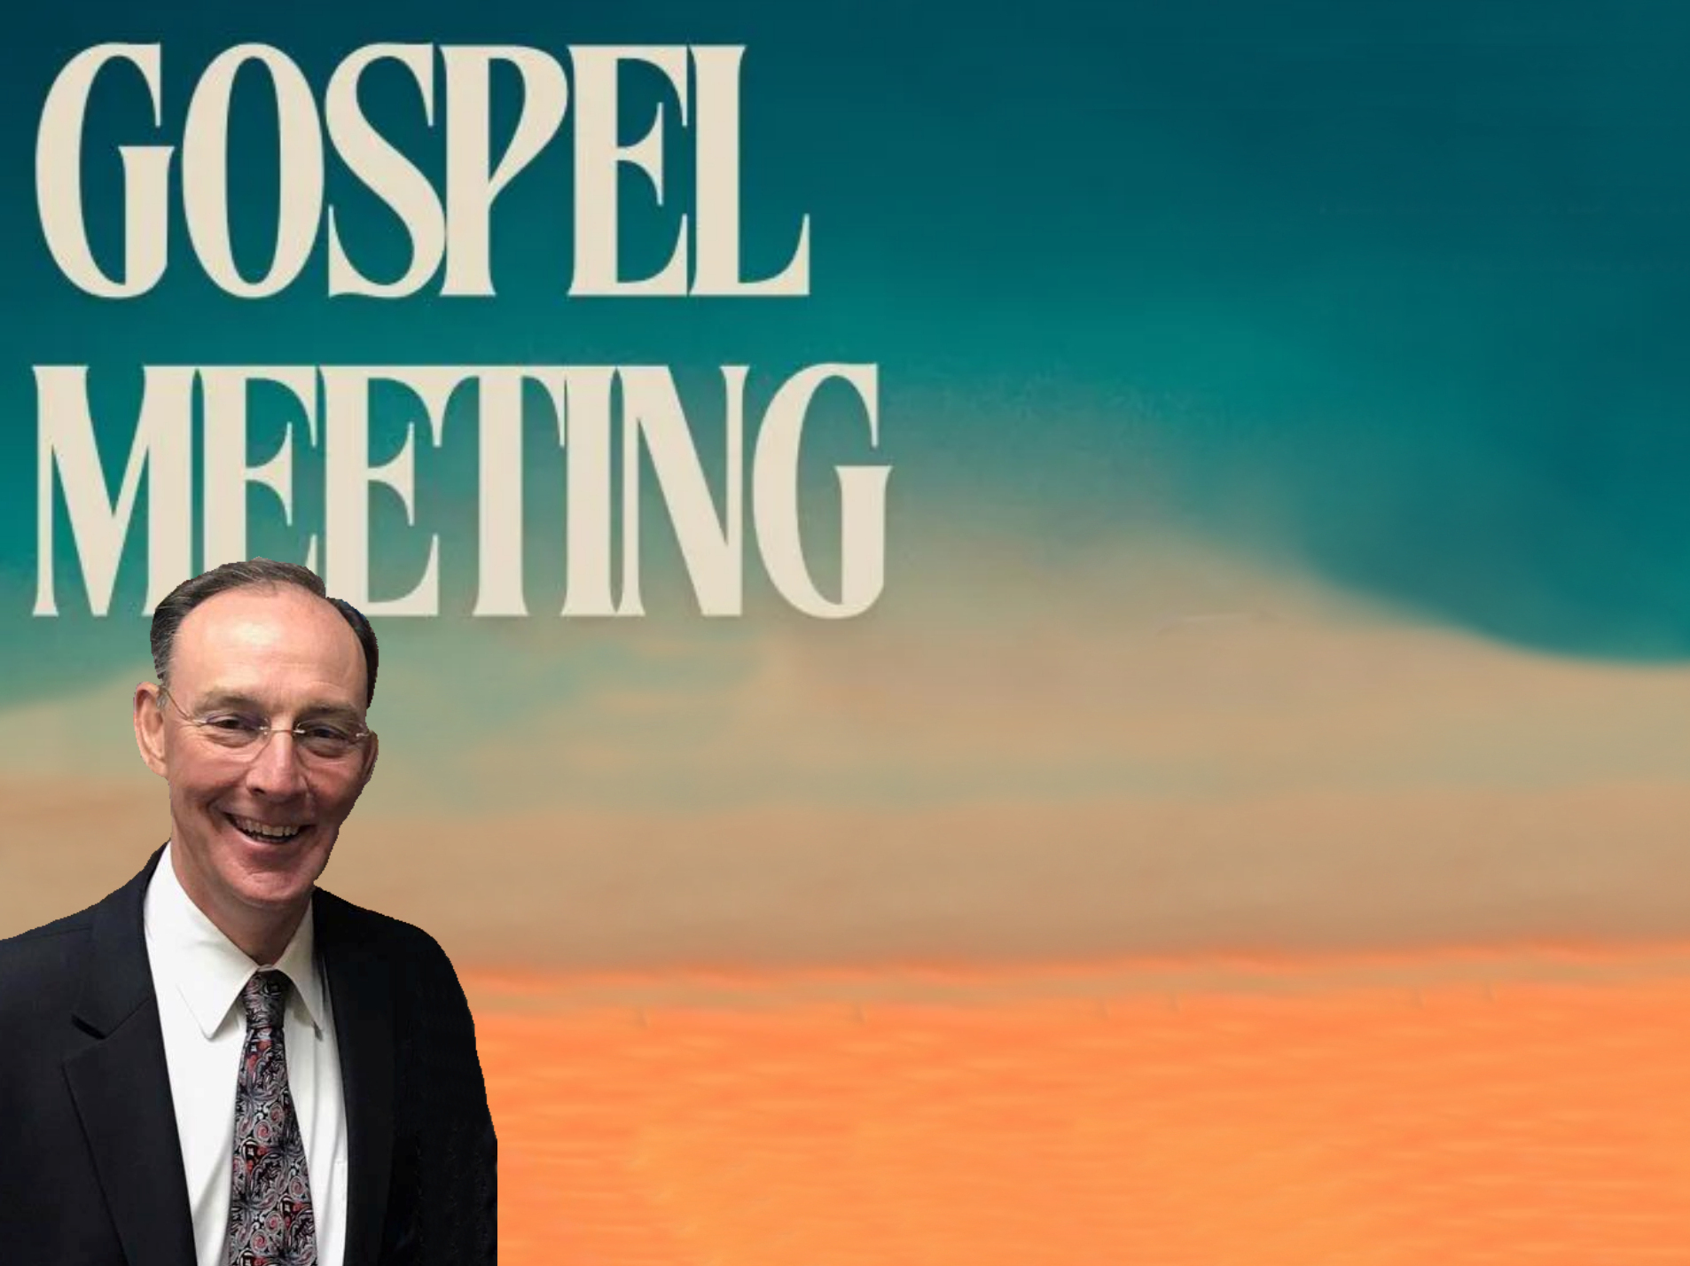
The Majesty of God
Micky Galloway

Slide 3
The Majesty Of God
Psalms 14:1 “The fool hath said in his heart, there is no God.”

Slide 4
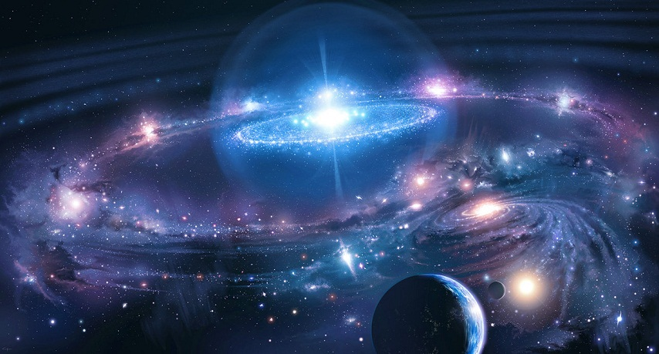
Genesis 1:1-2
“In the beginning God created the heavens and the earth. And the earth was waste and void; and darkness was upon the face of the deep: and the Spirit of God moved upon the face of the waters.”
Man has often been a fool!
Cf. Romans 1:20ff

Slide 5
Commanded To FEAR God
Angel said, “... with a great voice, Fear God, and give him glory; for the hour of his judgment is come: and worship him that made the heaven and the earth and sea and fountains of waters.” Revelation 14:7
  “phoberós: to fear, be afraid; absolutely to be struck with fear, to be seized with alarm... to reverence, venerate, to treat with deference or reverential obedience” (Thayer)
  Cf. Revelation 1:13-17

Slide 6
Revelation 14:7
“Fear God and give glory to Him . . .”
Psalms 99:1-3 “Jehovah reigneth; let the peoples tremble: He sitteth (above) the cherubim; let the earth be moved. Jehovah is great in Zion; and he is high above all the peoples. Let them praise thy great and terrible name: Holy is he.”
Psalms 111:9 “He has sent redemption to His people; He has commanded His covenant forever: Holy and awesome is His name.” NKJV
Nehemiah 1:5 “I beseech thee, O Jehovah, the God of heaven, the great and terrible (Awesome NASV) God…”

Slide 7
Revelation 14:7
“Fear God and give glory to Him . . .”
Hebrews 12:28-29 “Wherefore, receiving a kingdom that cannot be shaken, let us have grace, whereby we may offer service well-pleasing to God with reverence and awe: for our God is a consuming fire.”

Slide 8
Revelation 14:7
“Fear God and give glory to Him . . .”
Isaiah 6:1-3 “In the year that king Uzziah died I saw the Lord sitting upon a throne, high and lifted up; and his train filled the temple. Above him stood the seraphim: each one had six wings; with twain he covered his face, and with twain he covered his feet, and with twain he did fly. And one cried unto another, and said, Holy, holy, holy, is Jehovah of hosts: the whole earth is full of his glory. “Cf. Revelation 4:8-11
Sacred

Slide 9
The Majesty Of God Revealed --Harmony Of Science And The Bible
Psalms 19:1-4 “The heavens declare the glory of God; and the firmament showeth his handiwork. Day unto day uttereth speech, and night unto night showeth knowledge. There is no speech nor language; their voice is not heard. Their line is gone out through all the earth, and their words to the end of the world.”

Slide 10
A Round Earth - Proverbs 8:27 (~1000 BC);
Isaiah 40:22 (740-690 BC).
384-322 BC: Aristotle (ancient Greek philosopher and scientist, one of the greatest intellectual figures of Western history britannica.com). .. argued for a spherical earth, but few were convinced.
1520 AD: Introduction of the compass & voyages of Columbus & Magellan finally brought general acceptance that the earth is round.

Slide 11
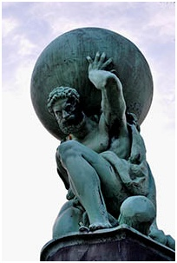
Suspension Of Earth In Space –
Job 26:7 (2000-1600 BC). (Clear, in unscientific terms.)
When men thought earth flat & supported.
1608 AD: Invention of the telescope by a Dutch optician, Hans Lippershey.
1687 AD: Sir Isaac Newton & his "Law of Universal Gravitation" (Principia). The earth is suspended in its orbit by the attraction of the sun.
Earth weighs six billion trillion (6 x 1021) tons. To replace the gravitational pull of the sun it would take the strength of a steel cable 8,000 miles in diameter!

Slide 12
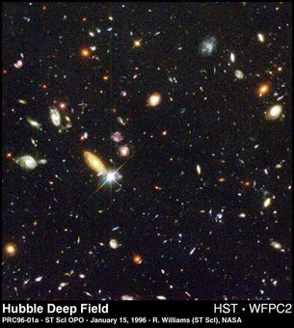
Number Of Stars - Genesis 15:5; 22:17; (~1400 BC); Jeremiah 33:22 (~600 BC). (cf. Isaiah 40:26; Psalms 147:4; Romans 1:20)
150 BC: Hipparchus taught there were less than 3,000 stars. (A Greek astronomer and mathematician who discovered the precession of the equinoxes, calculated the length of the year to within 6 1/2 minutes, compiled the first known star catalog, and made an early formulation of trigonometry.)
150 AD: Ptolemy counted 1,056 & claimed the actual number was not over 3,000.
1608 AD: Galileo used a telescope and announced the number of stars "innumerable.“
Today, Astronomers estimate there are about 100 thousand million stars in the Milky Way alone.
Pleiades and Orion as gravitationally bound star groups. Job 38:31
Every star is different. 1 Corinthians 15:41
Stars sing. Job 38:7

Slide 13
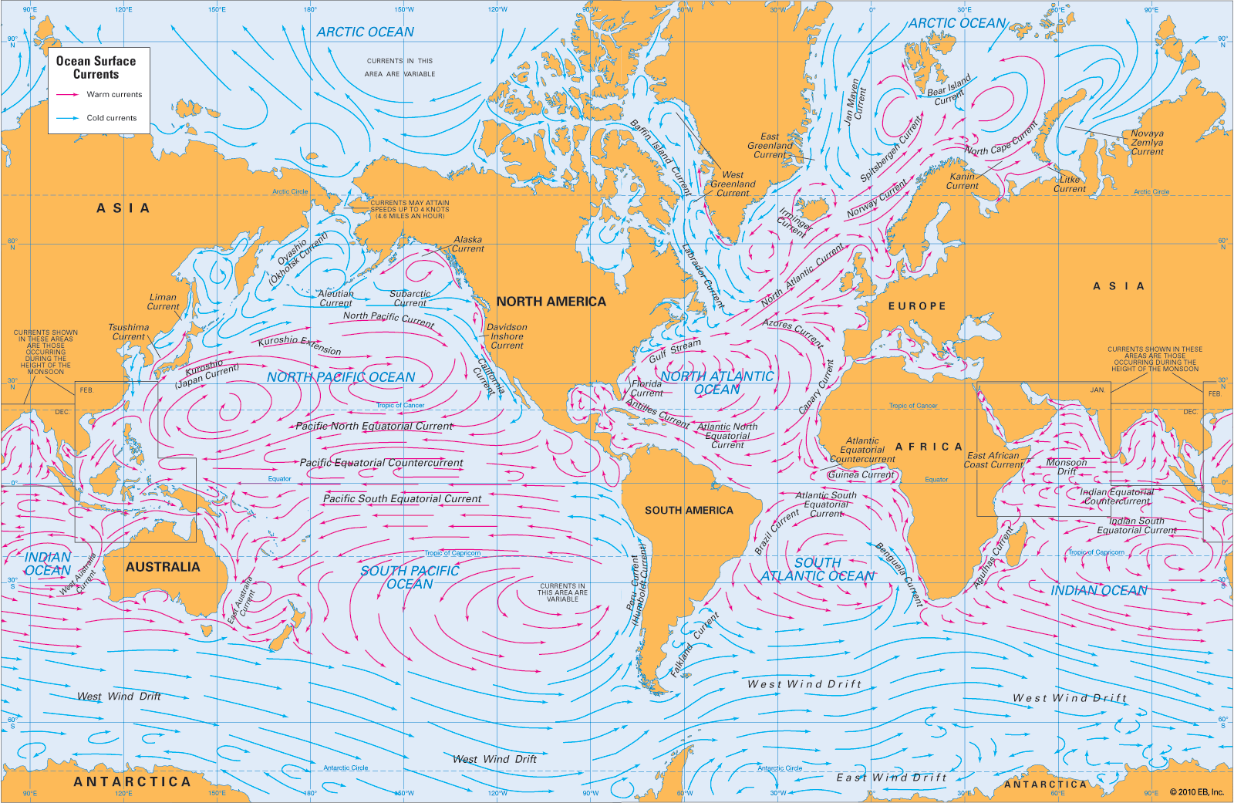
Paths Of The Seas - Psalms 8:8
(~1000 BC).
1855 AD: Matthew Fontaine Maury an American astronomer, historian, oceanographer, meteorologist, cartographer, author, geologist, educator, and naval officer, upon hearing Psalm 8:8 read to him by his son, set out to discover & chart the oceans' sea lanes & currents. (Statue of Maury in Richmond, VA).Nicknamed “the Pathfinder of Seas.”

Slide 14
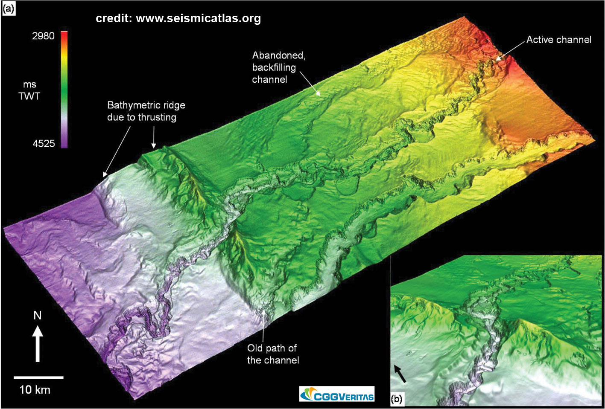
Channels In The Sea - 2 Samuel 22:16 (~1000 BC).
1504 AD: Juan de la Costa made the first ocean soundings, but did nothing to change the universal view that the ocean floors were flat, sandy beds like our deserts.
1840 AD: James Clark Rose made oceanic soundings to a depth of nearly 2,000 fathoms (12,000 ft.).
1971 AD: First complete map of the ocean floor showing the "recesses of the deep."

Slide 15
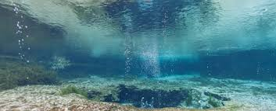
Springs Of The Sea - Job 38:16 (~2000-1600 BC); Genesis 7:11; 8:2 (~1400 BC.)
1930 AD: Fresh water springs on the ocean floor.
Scientists have discovered huge reserves of freshwater beneath the oceans kilometers out to sea, providing new opportunities to stave off a looming global water crisis… "The volume of this water resource is a hundred times greater than the amount we've extracted from the Earth's sub-surface in the past century since 1900,“ Dr Vincent Post of the National Centre for Groundwater Research and Training (NCGRT) and the School of the Environment at Flinders University. https://www.sciencedaily.com/releases/2013/12/131208085304.htm December 8, 2013

Slide 16

Springs Of The Sea - Job 38:16 (~2000-1600 BC); Genesis 7:11; 8:2 (~1400 BC.)
1945 AD: Underwater volcanoes discovered.
“Although most of the active volcanoes we see on land occur where plates collide, the greatest number of the Earth's volcanoes are hidden from view, occurring on the ocean floor along spreading ridges.” https://oceanservice.noaa.gov/facts/volcanoes.html
We All Nearly Missed The Largest Underwater Volcano Eruption Ever Recorded. Wha? PETER DOCKRILL 15 JAN 2018

Slide 17
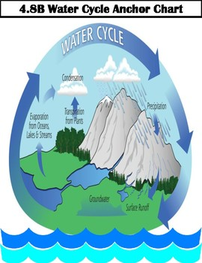
The Water-Vapor Cycle - Job 36:27-28 (2000-1600 BC); Ecclesiastes 1:7 (~1000 BC).
Sea not full - Evaporation & water cycles.
350 BC: Aristotle comprehended the water-vapor cycle & published his "Meteorlogica".
1770 AD: Benjamin Franklin observed movement of water by storms (river-to-sea-river water cycle).

Slide 18
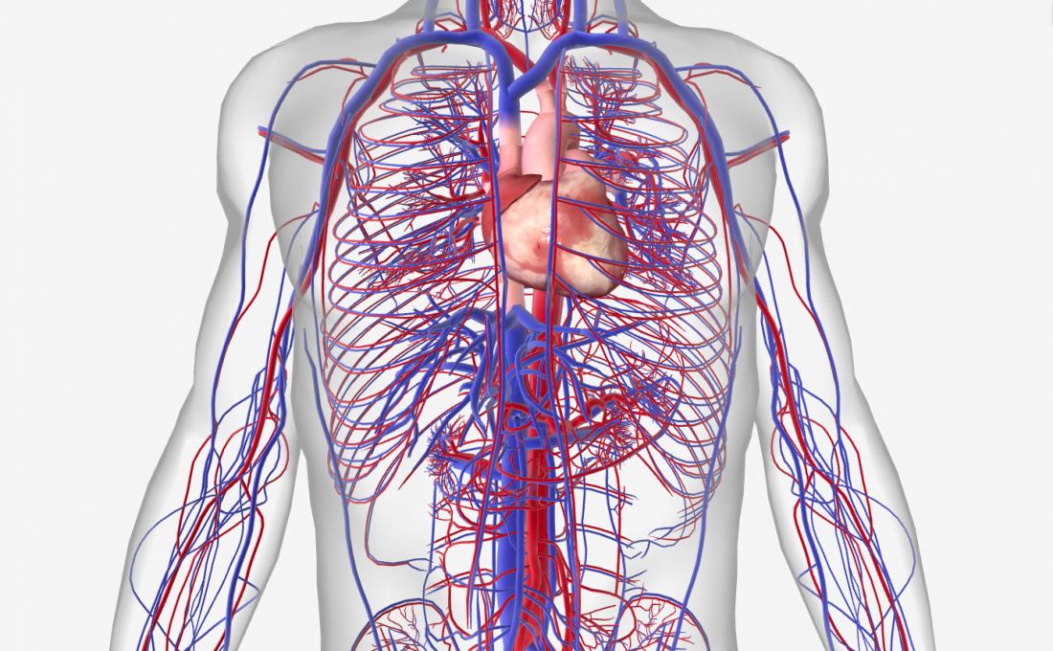
Life Is In The Blood - Leviticus 17:11
(~1400 BC)
~350 BC: Herophilos, physician of the Museum of Alexandria, advocated blood letting as a means to get rid of disease.
1616 AD: Dr. William Harvey, British physician, discovered blood circulates & is used over & over.
  Circulatory system involves estimated 60,000 - 80,000 miles (earth is 25,000 miles around) circulates an average of 1400 times a day.
https://my.clevelandclinic.org/health/articles/17059-how-does-blood-flow-through-your-body#:~:text=This%20vast%20system%20of%20blood,through%20your%20body's%20blood%20vessels.

Slide 19
Cosmology/Astronomy
Time had a beginning. 2 Timothy 1:9, Titus 1:2,
1 Corinthians 2:7; Genesis 1:1, 2:4, Isaiah 42:5, etc.
The universe was created from the invisible. Hebrews 11:3
The dimensions of the universe were created. Romans 8:38-39
The universe is expanding. Job 9:8, Psalms 104:2, Isaiah 40:22, Isaiah 42:5, Isaiah 44:24, Isaiah 45:12, Isaiah 48:13, Isaiah 51:13, Jeremiah 10:12, Jeremiah 51:15,
Zechariah 12:1
The universe is winding down and will "wear out" (second law of thermodynamics ensures that the universe will run down). Psalms 102:25-27

Slide 20
Reverence Is A Response To The Majesty Of God
To God’s Majestic Glory.
  Moses hid his face. Exodus 3:6
  Changes who you are! Luke 5:8
    Be holy. 1 Peter 1:14-16
    Partakers of the divine nature. 2 Peter 1:4
    The way you look at sin! 1 Peter 4:3

Slide 21
Reverence Is A Response To The Majesty Of God
To God’s Incredible Power.
  Noah moved with godly fear. Hebrews 11:7;
  cf. 2 Peter 3:5ff
  Abraham offered up Isaac. Hebrews 11:17;
  cf. Genesis 22:11
  Ninevites repented. Jonah 3:4-5
  Believed God!!! Cf. Acts 27:22-25

Slide 22
Reverence Is A Response To The Majesty Of God
To God’s Amazing Grace And Mercy. Ephesus 2:8-9; cf. Romans 3:22-26
  Will transform who you are.
  Romans 11:30-32; 12:1-2

Slide 23
Without Reverence for the Majesty of God
There Is No Change
“…. There is no fear of God before their eyes.” Romans 3:10-18
When we stand in AWE of God, we will change.
Ps 139:6 “(Such) knowledge is too wonderful for me; it is high, I cannot attain unto it.”
  Dress. 1 Timothy 2:9-10
  Speech. Matthew 6:9
  Lives. 1 Corinthians 6:9-11

