Slide 2
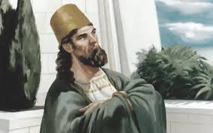
What Do You Want to Hear?
I Kings 22: 5-39
King Ahab – King of Israel
Ninth Century BC
22 Year Reign
I Kings 16:29-30

Slide 3
“The Truth” and King Ahab
Ahab’s Desire Reclaim “Ramoth-Gilead” ( I Kings. 22:3-4)
Insistence of King Jehoshaphat – “Inquire First” (I Kings 22:5)
400 Prophets – “Thus saith Jehovah” “He will deliver it” ( I Kings 22: 6, 11-12)
Micaiah –Ahab hates: does not prophesy “good” for me – only “evil” (I Kings 22:8-9)
Micaiah’s shocking Response: “Jehovah will deliver it into the hand of the king ” (I Kings 22:15)

Slide 4
The Truth
Micaiah – are you being deceptive? (I Kings 22:17, 36, 28, 35 , 38, I Kings 21:19)?
Who possesses the “lying spirit” ? ( I Kings 22:19-23)
Wanting the truth or wanting what pleases us?
Genuine love of truth or perish? (2 Thess. 2:10-12)
400 teachers can all agree to lie when pleasing you is their motive...

