Slide 1
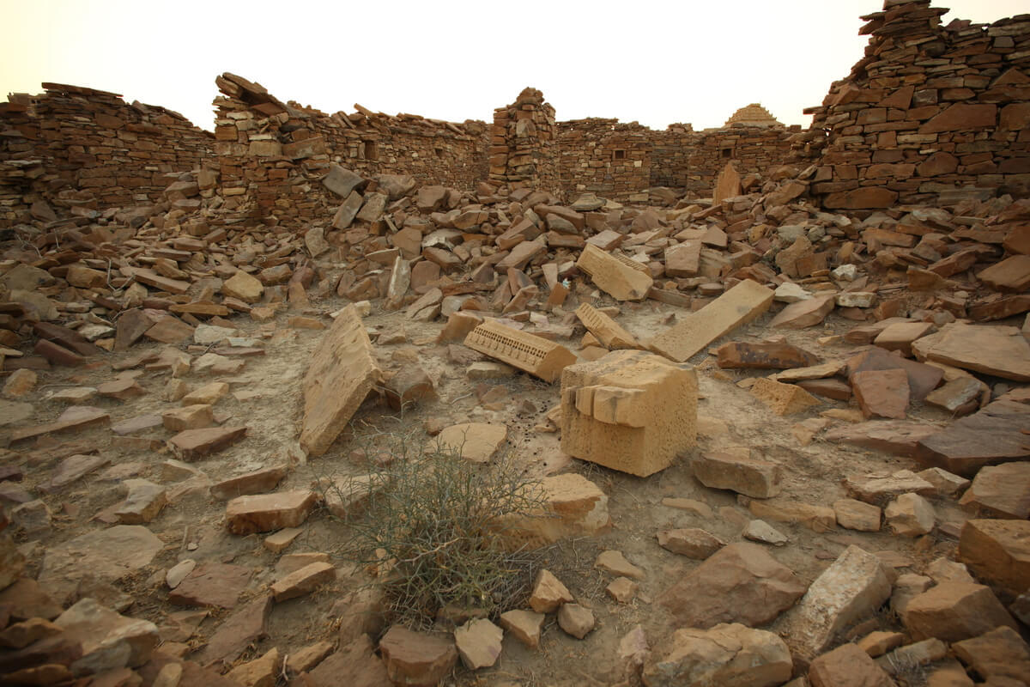
What do the tombs opening at the death of Jesus mean?

Slide 2
Matthew’s account of death of Jesus
And behold, the veil of the temple was rent in two from the top to the bottom; and the earth did quake; and the rocks were rent; and the tombs were opened; and many bodies of the saints that had fallen asleep were raised...
Matthew and Mark “rent top to bottom” (Mk. 15:38)
Luke –”rent in the midst” (Lk. 23::45)

Slide 3
What does the renting and raising of bodies mean...
Separation has been Overcome: “renting” of veil and “renting” of the rocks – opened tombs
  The way to holy place opened – through the veil of Jesus’ flesh (Heb. 10:19-20)
  Tombs opened – separation of death overcome
Death defeated by “death” emphasis (Heb. 2:14, 13:20)
Life secured for Old Testament Saints (cf. Rom. 3:25)

Slide 4
What does the renting and raising of bodies mean...
Bodily resurrection emphasized for all (cf. I Corinthians 15:42-44)
Resurrected Old Testament Saints enter “Holy City” – there is time to repent even when you have crucified the Christ – Messiah
The Witness of the Centurian – what he had seen and heard (Lk. 23: 46-47; Mk. 15:37-39; Matt. 27:54)
  Jesus a righteous man
  Jesus the Son of God

