Slide 2
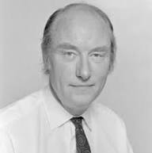
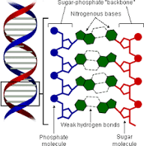
“You, your joys and your sorrows, your memories and your ambitions, your sense of personal identity and free will, are in fact no more than the behavior of a vast assembly of nerve cells and their associated molecules” The Astonishing Hypothesis, 3.
Francis Crick
1916-2004
You are what happens materially in your brain... When your brain function ends, your personhood ends – lights out – Poof!
1953

Slide 3
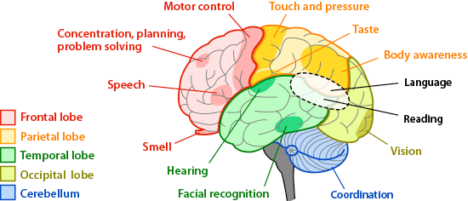
When we are declared dead – “Brain-dead: - Do our senses cease?

Slide 4
After Physical Death... Buried or Not... Luke 16:22-31
Sense of eyesight – can see (v.23)
Sense of pain – in anguish (v. 24)
Understand the concept of mercy and touch (v. 24)
Able to remember – facts of our “life-time” (v. 25)
Able to reason – Send warning so my five brothers so they do not come to this place of torment (v.28, 30)

Slide 5
Revelation 6:9-10
And when he opened the fifth seal, I saw underneath the altar the souls of them that had been slain for the word of God, and for the testimony which they held: and they cried with a great voice, saying, How long, O Master, the holy and true, dost thou not judge and avenge our blood on them that dwell on the earth?
Sous no

Slide 6
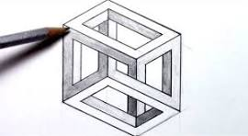
Dimensions perceived just from drawing lines on a flat one-dimension surface

Slide 7
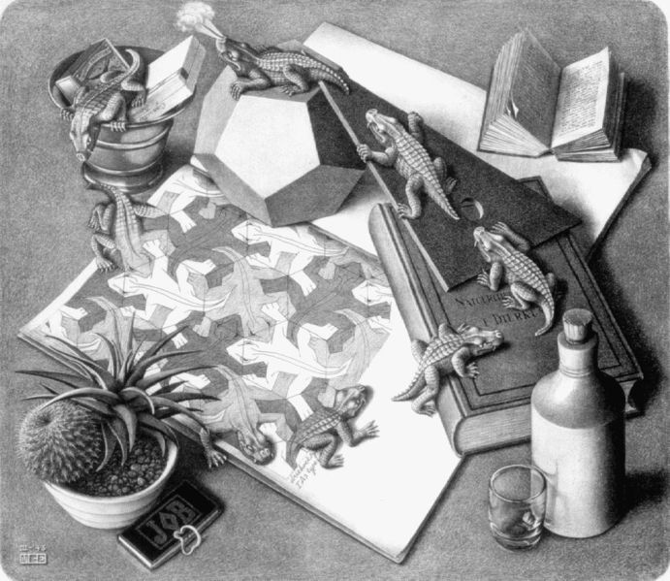
M. C. Escher- 1898-1972
Reptiles
We can perceive of greater dimensions on a flat surface

Slide 8
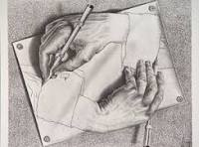
Maurits Cornelius Escher - 1898-1972

Slide 9
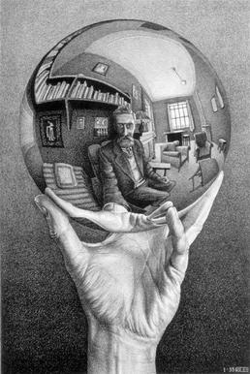
Hand with Reflecting Sphere
C. S. Lewis – Wight of Glory - Essay “Transposition”

Slide 10
Our “Lively Hope”...
Heaven – incorruptible, undefiled, fades not away (I Pet. 1:3-5)
Incorruptible - Glorified – Spiritual – Body (I Cor. 15:42-44)
Formed after the glorified body of Christ (Phil. 3:20-21)
Will See Him as He is (I Jn. 3:2-3)

